Slide 1
Report 06/29/2020
P. Hacker

Slide 2
Previously: Geometry Sensitivity Study
prime radiation feedback controlled discharge 20181010.032 exhibits transitions from attached to detached states and back (90%-100% radiation fraction)
calculate STRAHL radiation profiles with given electron temperature and density at distinct radiation fraction levels to investigate intrinsic (oxygen and carbon) impurity radiation
STRAHL profiles show asymmetric chordal profiles after forward calculation with emissivity matrices, though being symmetric

Slide 3
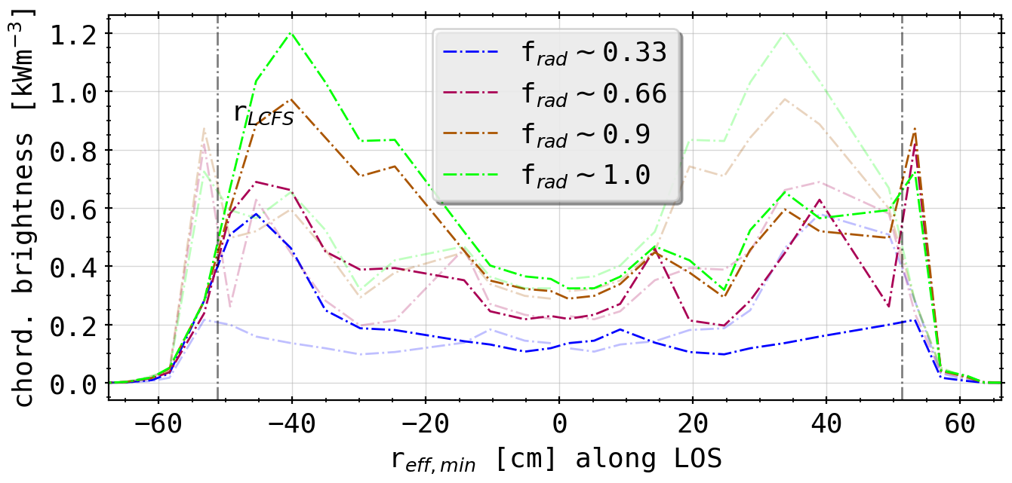
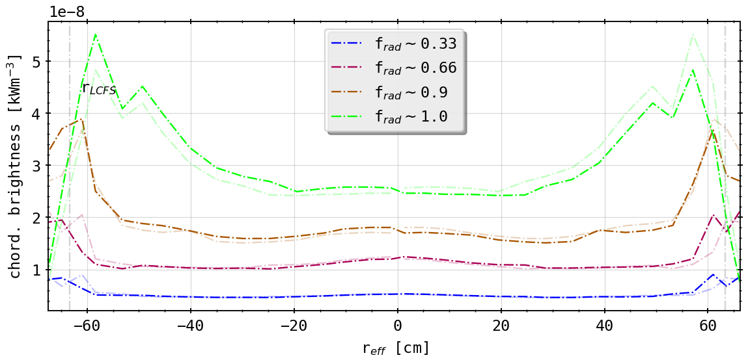
Previously: Geometry Sensitivity Study
STRAHL profiles show asymmetric chordal profiles after forward calculation with emissivity matrices, though being intrinsicly symmetric
(chordal profile 20181010.032, HBCm)
(chordal profile from STRAHL, HBCm)

Slide 4
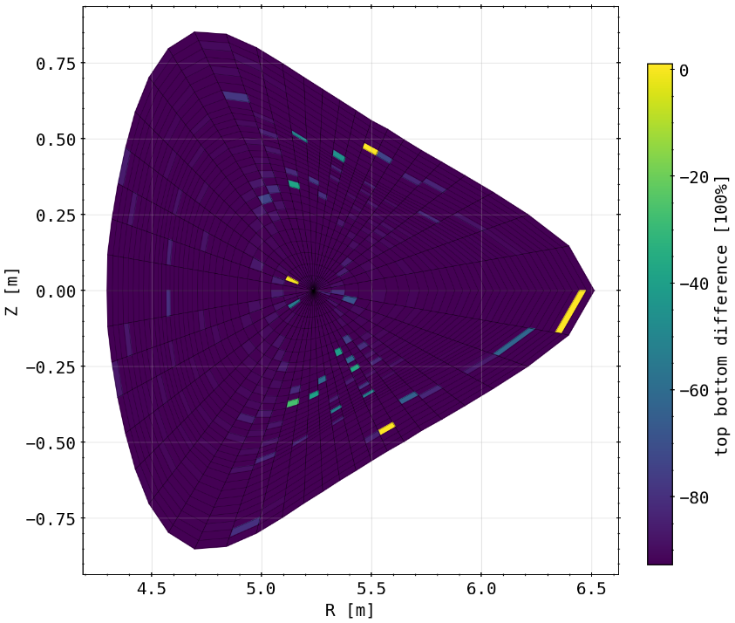
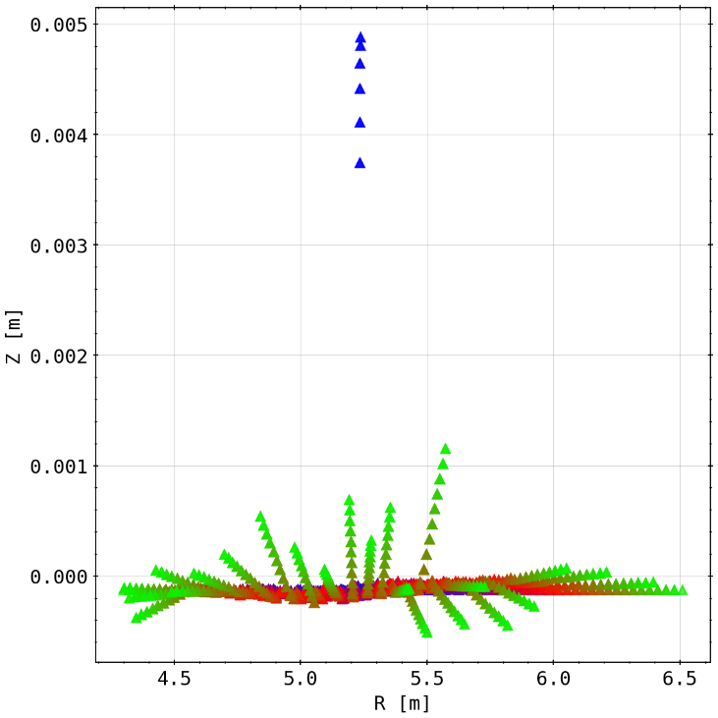
Results: Symmetry of Emissivity Matrix and Mesh
checking the symmetry (read: top-bottom congruence) of the emissivity matrix projected to the Bolometer plane
slight deviances overall, especially some cells not ‘touched’ by channels at all (equaling 100% difference here)
checking symmetry mesh matrix
blue to red to green means further outside the magnetic axis, i.e. ‘larger’ fluxsurfaces/fluxtubes
entire mesh dispositioned downwards (still oriented around magnetic axis)
increasing deviance with distance

Slide 5
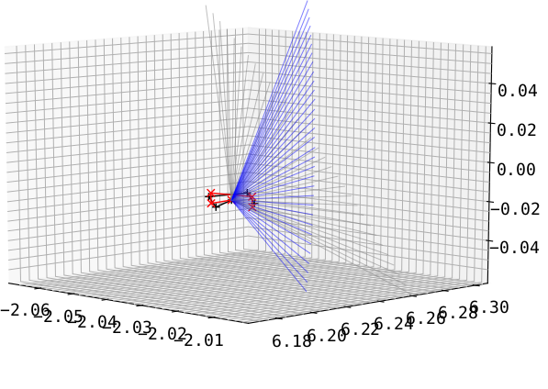
Results: Tilting the Detector Fan Up/Down
deviance in STRAHL possibly results of intrinsic geometry
ALSO: testing more effects that could change the intrinsic geometry, which can not be analysed theoretically
take symmetric arrays and tilt the entire fan including the aperture poloidally (grey to blue and black to red)
HBCm
(results with aperture change included)

Slide 6
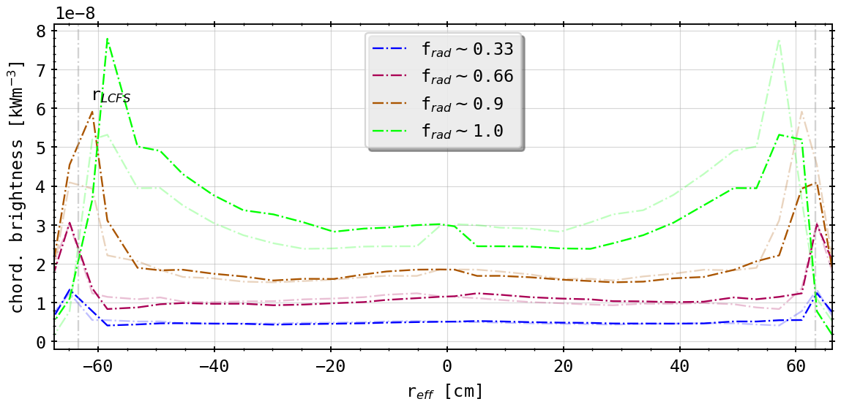
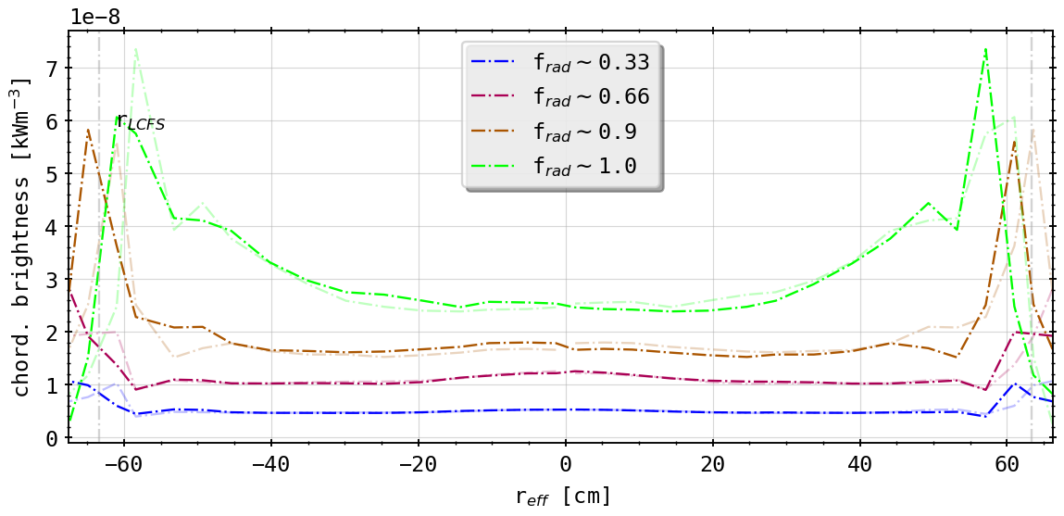
Results: Different Tilts from As-Built Geometry
(0.5° tilt (down))
(-0.5° tilt (up))
asymmetry switchable/changed around
alignment better now upside (tilt down!)
radial movement as before and in original

Slide 7
First Summary
geometry sensitivity study yields great insight on how the camera setup and errors effect forward calculations
results show that variety and possibly a combination of measurement and intrinsic geometry errors are responsible for further asymmetries in results
Camera geometry adequate to resolve radial shifts in 2D from STRAHL?
need 2D tomography of radiation distribution
benchmark Minimum Fischer Reqularization method for 2D inversion with variety of phantom radiation profiles with various distinct or mixed characteristics

Slide 8
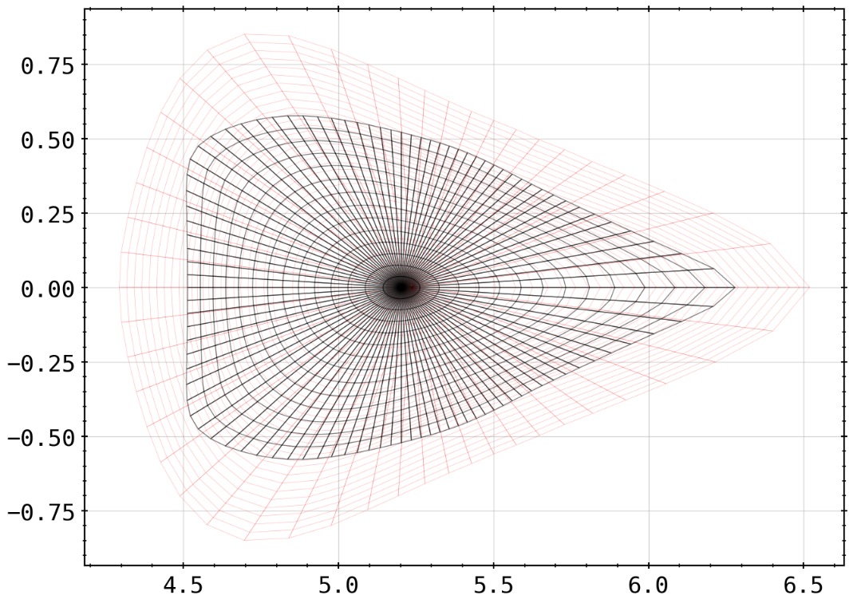
Previously: 2D Tomography - First Results
set up forward calculation of chordal brightness profile from the 2D results of tomography as shown before
change inversion domain according to magnetic configuration used in experimental or standard in case of phantoms
new EIM grid
‘old’ grid
(inversion grid base off EIM reference)

Slide 9
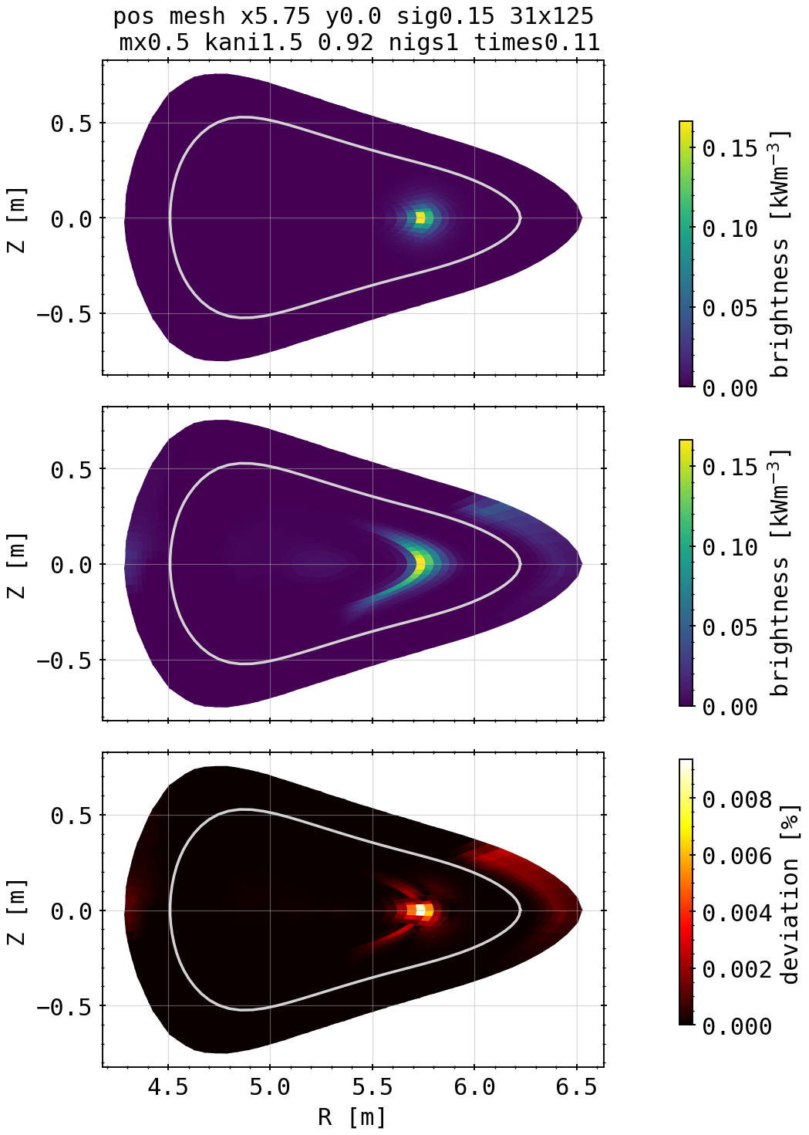
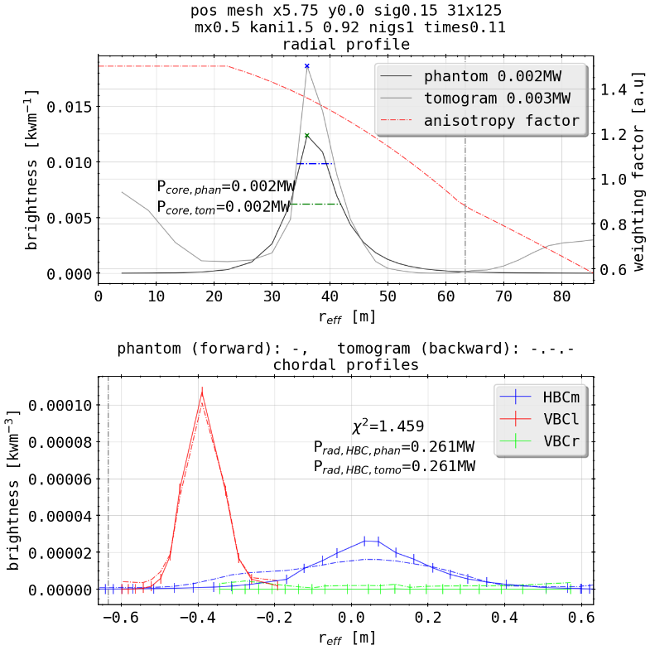
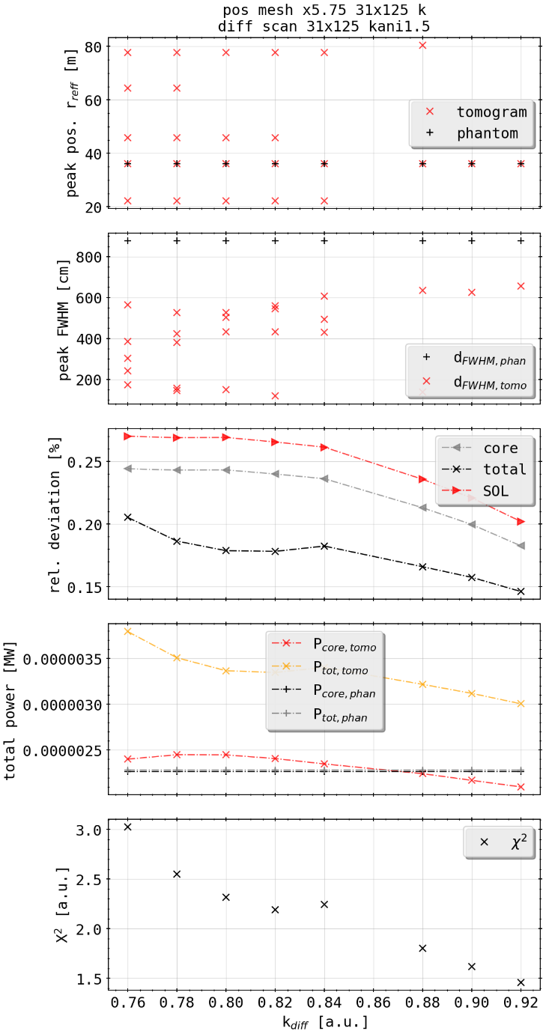
Phantom Test: Single Spot Off-Center
[cm]
(phantom)
[mm]
K factor scan
(tomogram)
radiation power calculated as usual like in experiments
total & core power estimated by hollow cylinders of fluxsurfaces from radial profile (unit errors, fix needed)

Slide 10
Phantom Test: Single Spot Off-Center
[cm]
(phantom)
[mm]
K factor scan
(tomogram)
radial profile peak localization and width of distribution
forward and backward calculated chordal profiles

Slide 11
Phantom Test: Single Spot Off-Center
[cm]
(phantom)
[mm]
K factor scan
(tomogram)
X² quality does not necessarily equal best tomogram, hence the need for 2D relative deviation as measure to find best fit
deviation percentage relative to area of cell & domain

Slide 12
Phantom Test: Single Spot Off-Center
[cm]
(phantom)
[mm]
K factor scan
(tomogram)
smoothing along fluxsurfaces, according to K factor weighting
deposition of emissivity at edge due to too many free parameters
bad reconstructions yield entirely different profiles (radial, multi peak)

Slide 13
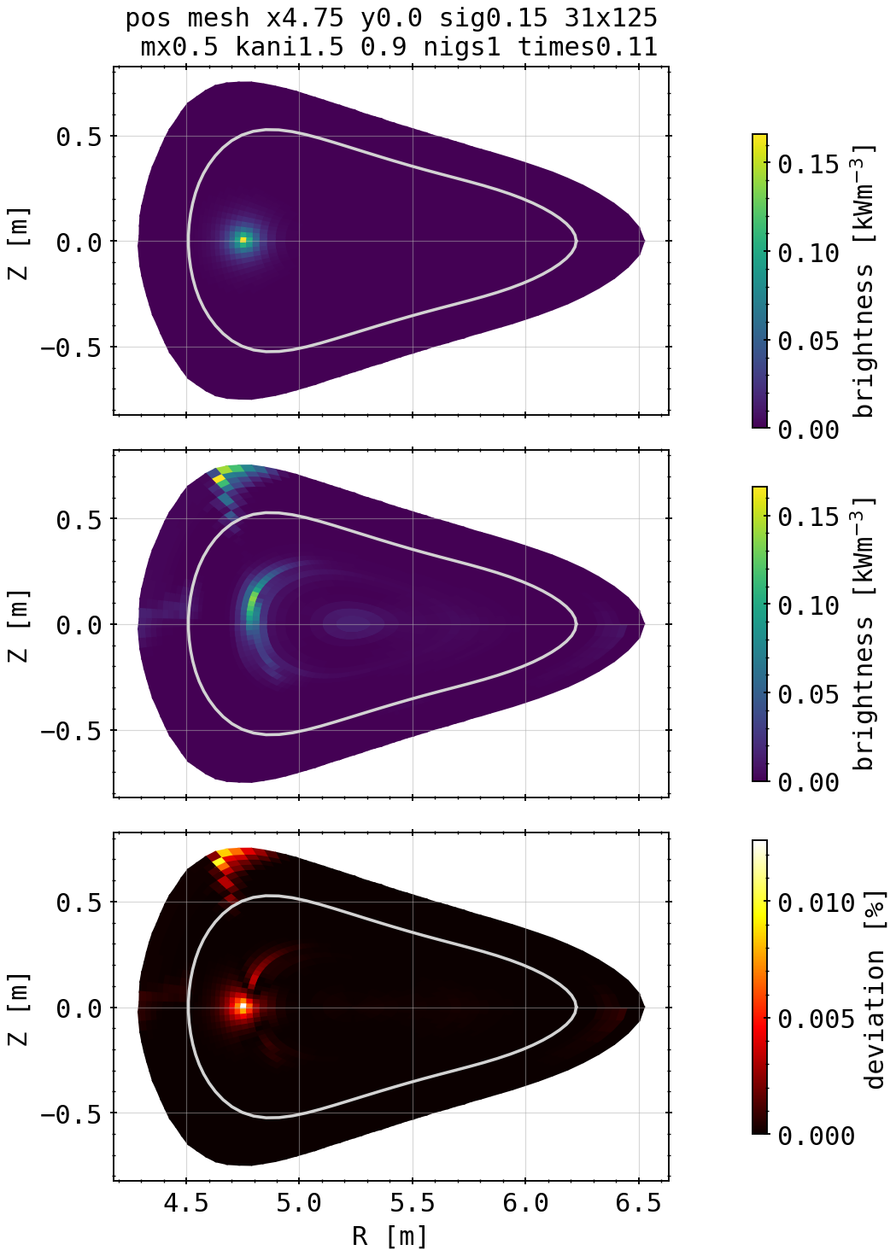
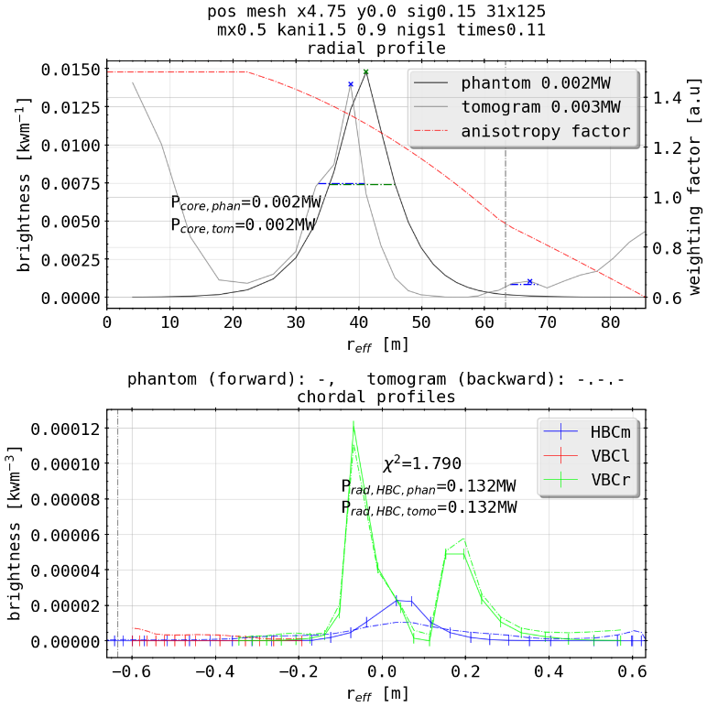
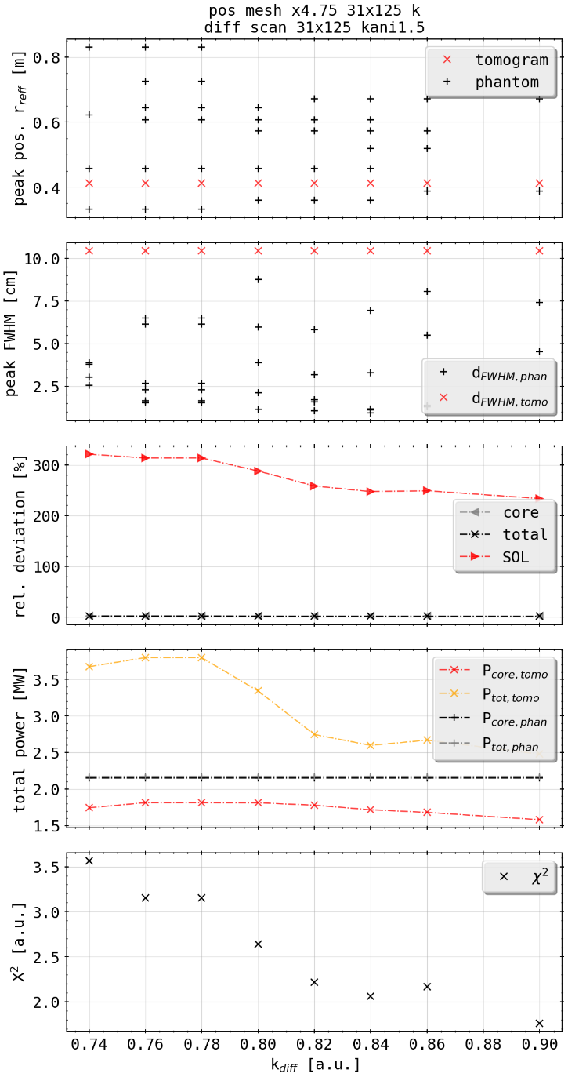
Phantom Test: Single Spot Off-Center (inboard)
(phantom)
K factor scan
(tomogram)
(no radiation in SOL)
line of sight density on inboard side too low, mostly dominated by VBCl/r
pixel bank on edge only graced by VBC detector, strong deposition
overall reconstruction quantitatively/qualitatively worse

Slide 14
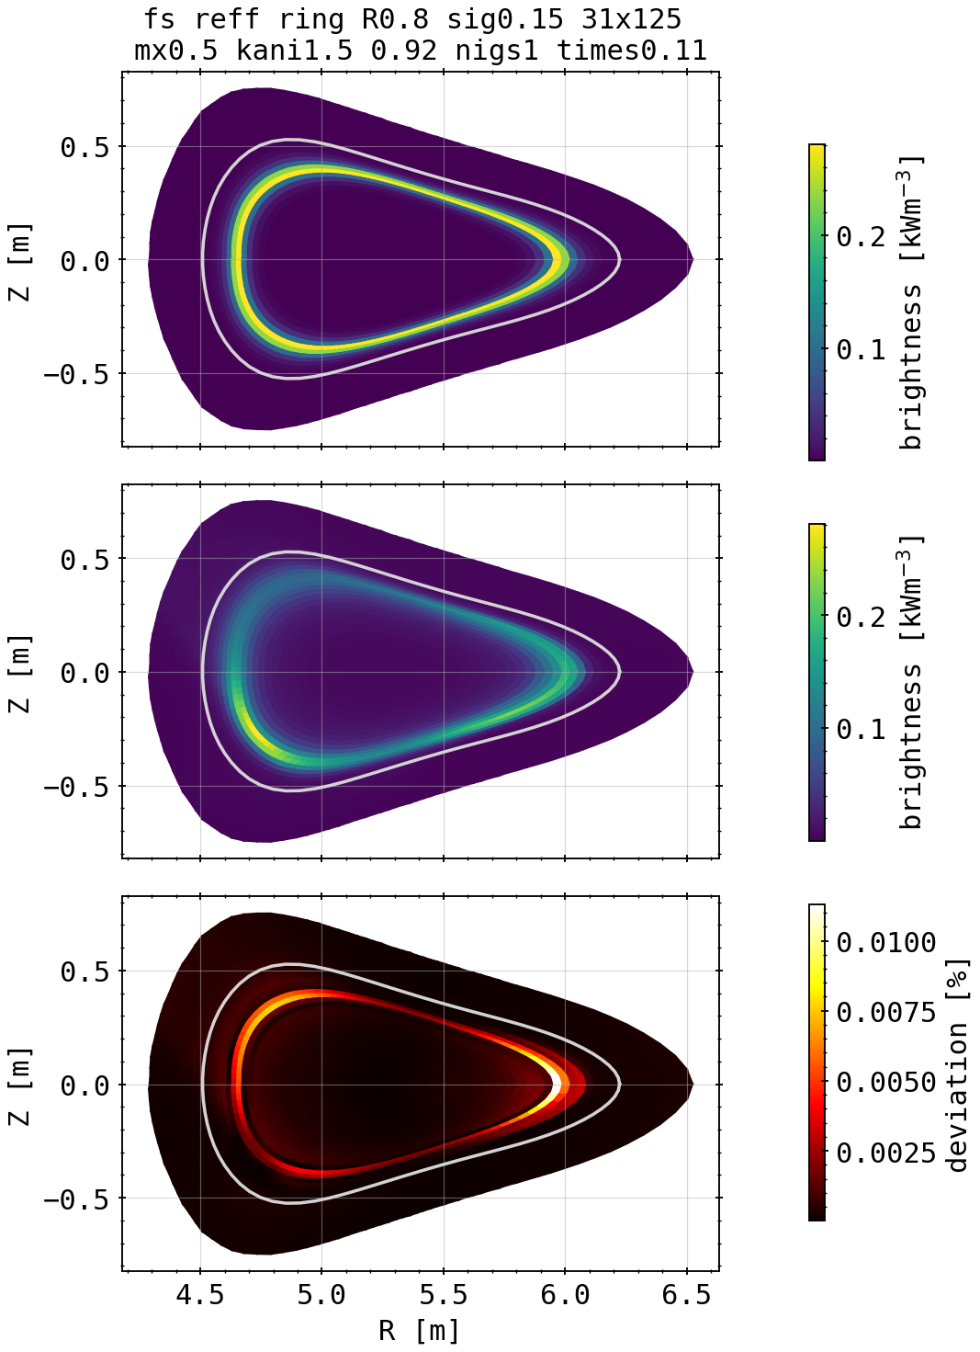
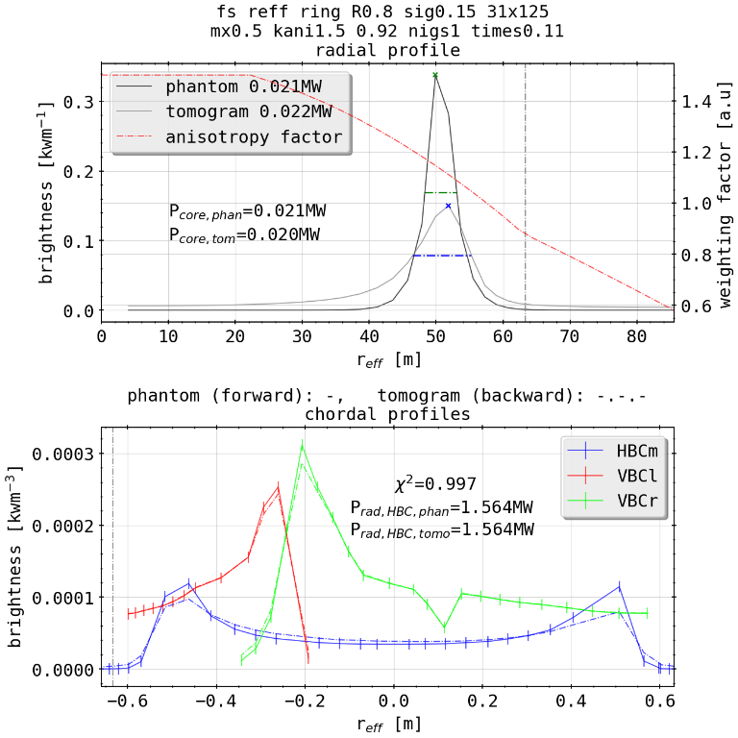
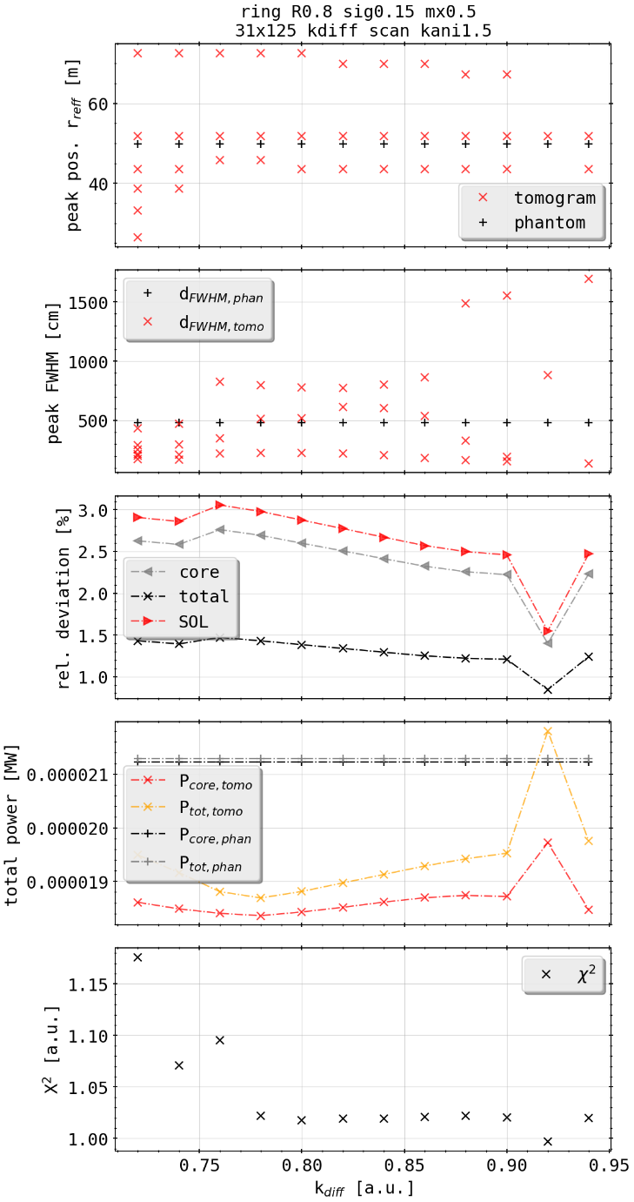
Phantom Test: Core Bright Ring
[cm]
(phantom)
[mm]
K factor scan
(tomogram)
exists best (not ideal?) set of weighting factors to find solution
poloidal anisotropy where higher LOS density (intersection HBC-VBC, close to VBC aperture)
bad reconstructions yield radial profiles with shells/large sigmas

Slide 15
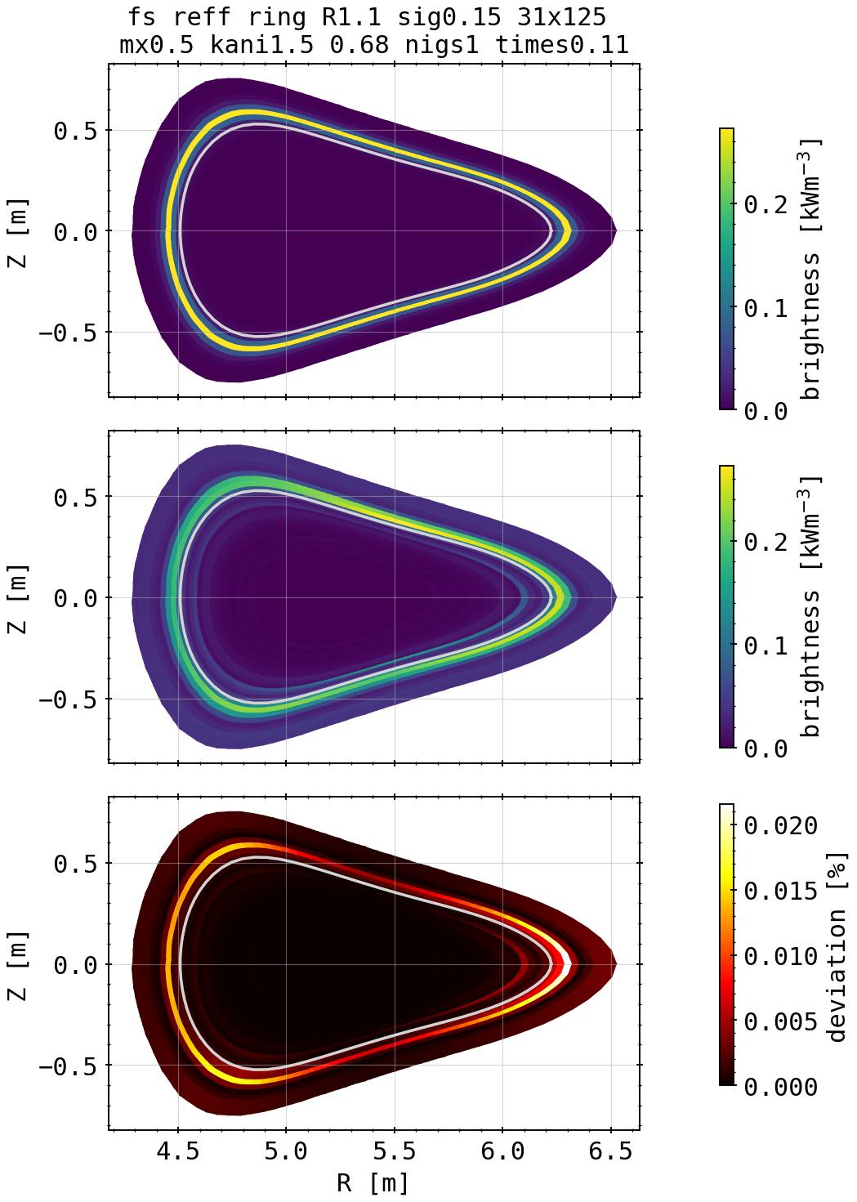
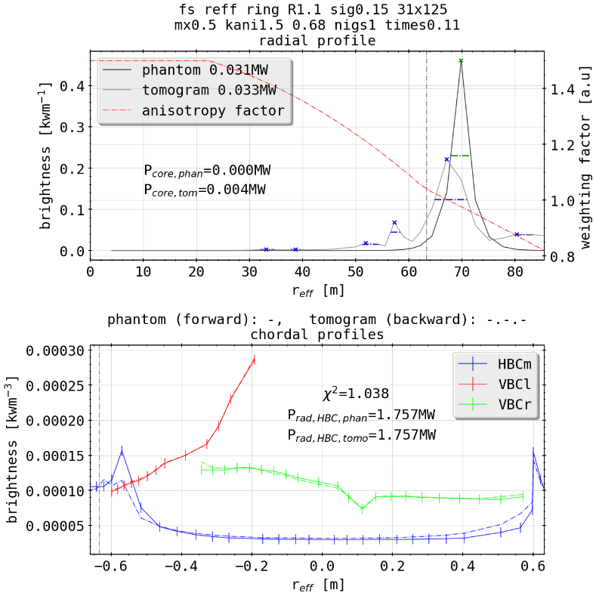
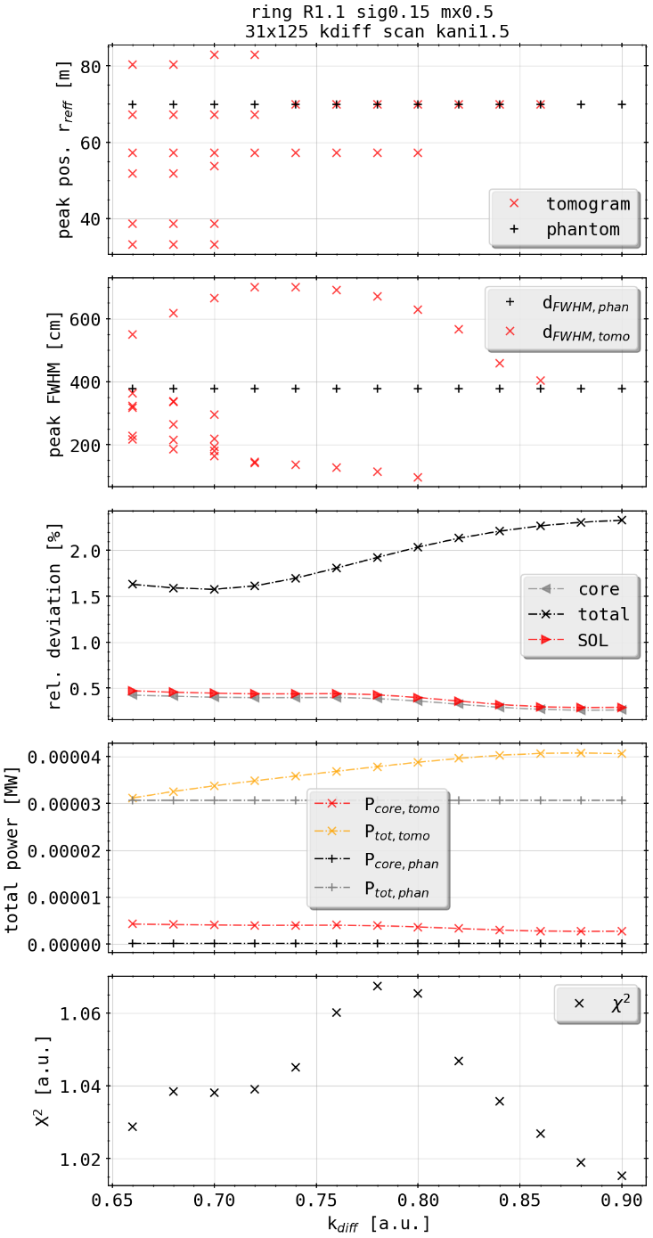
Phantom Test: SOL Bright Ring
[cm]
(phantom)
[mm]
K factor scan
(tomogram)
expectedly best K factor fit is on different end of spectrum (SOL focused?)
similar behavior with LOS density, but now upside-centered where line integration of HBC is very large
radial reconstruction slightly worse

Slide 16
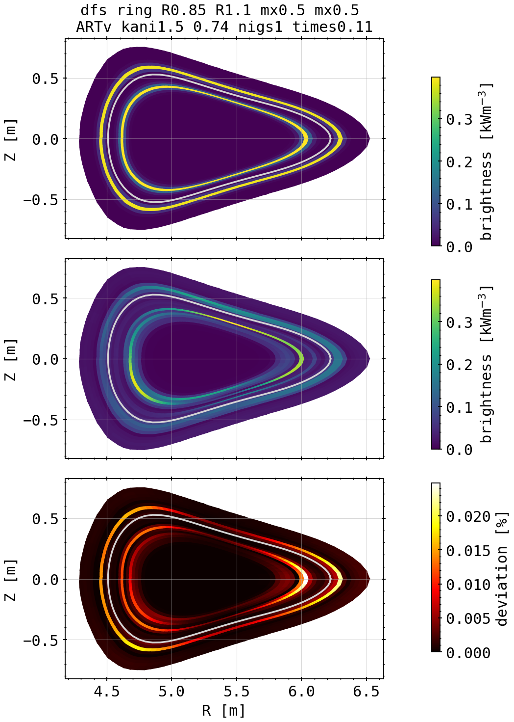
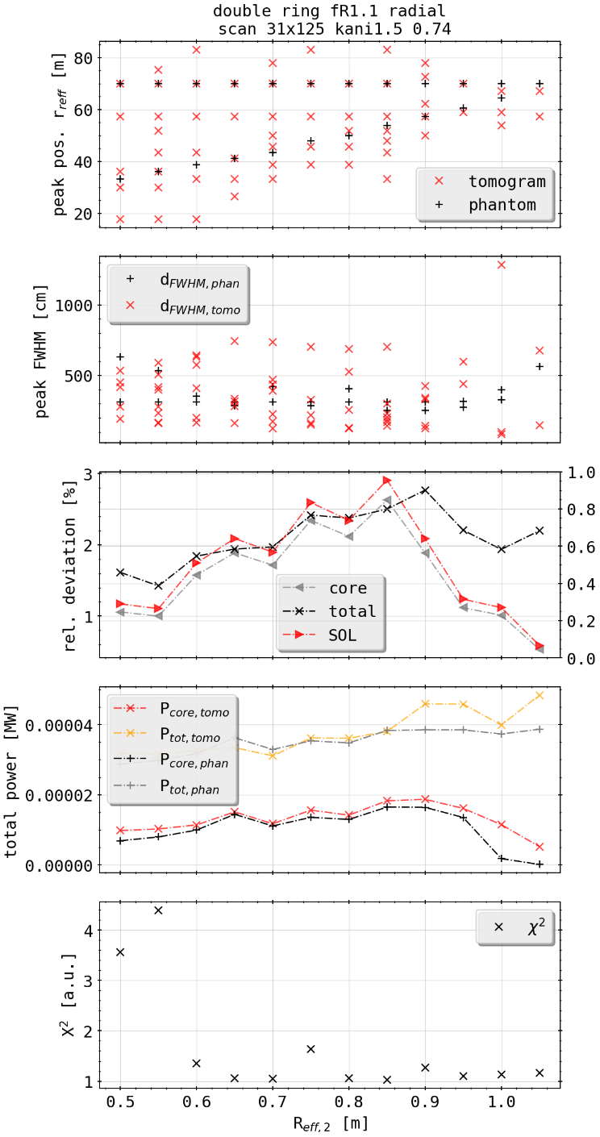
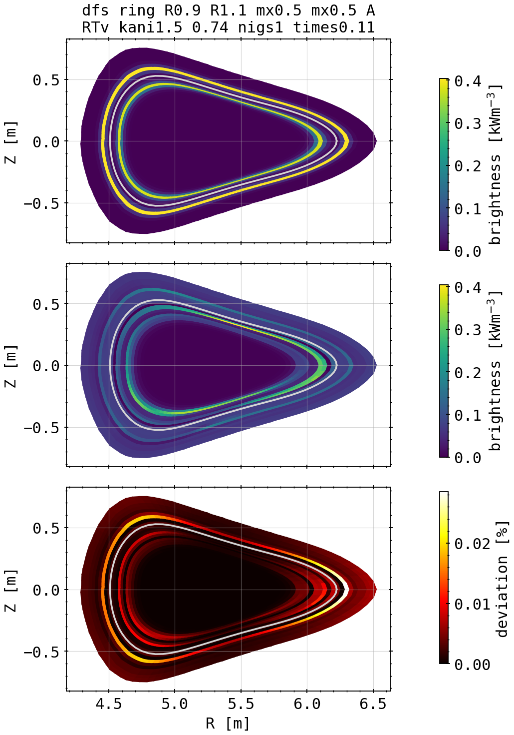
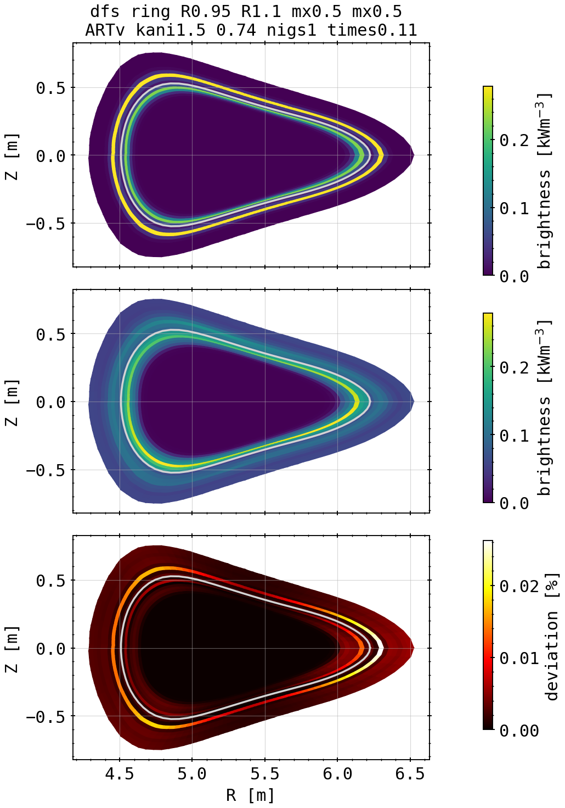
Phantom Test: Double Bright Rings
(1.1, 0.85)
(phantom)
[cm]
(1.1, 0.85)
[mm]
(1.1, 0.9)
double bright rings, one fixed at 1.1 x effective radius, then radially scan second one with same amplitude
shadowing of outside ring over inside, maxima not very well identifiable the closer the rings
mixing poloidal anisotropies like before, creating shell structures
tomograms
radial scan
(1.1, 0.95)

Slide 17
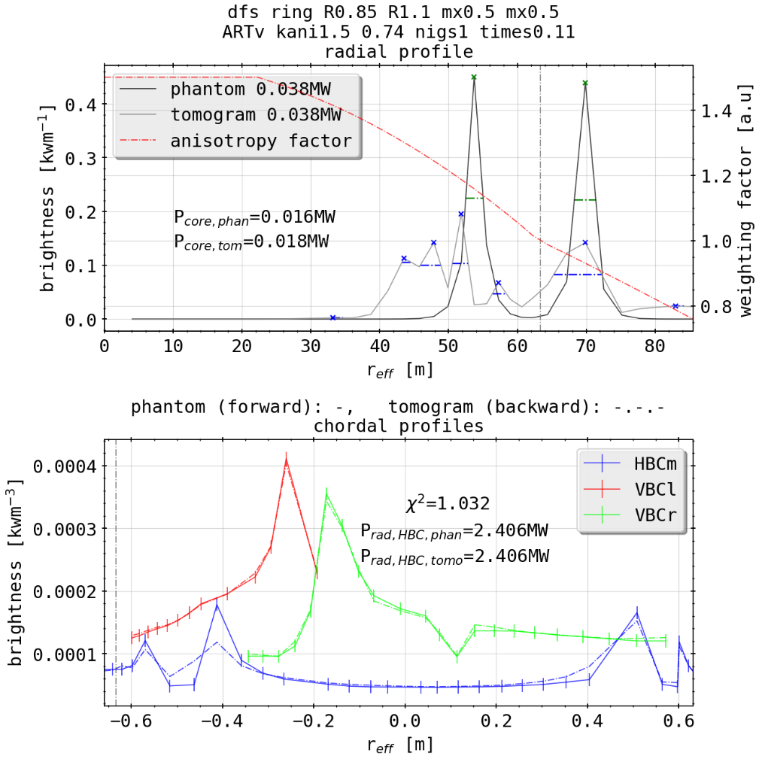
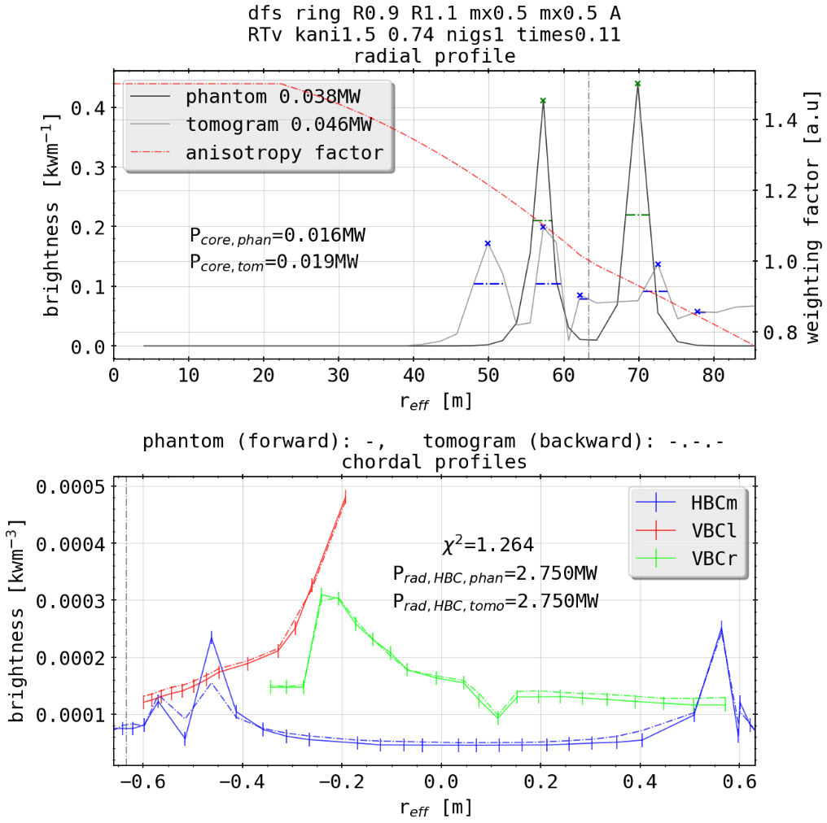
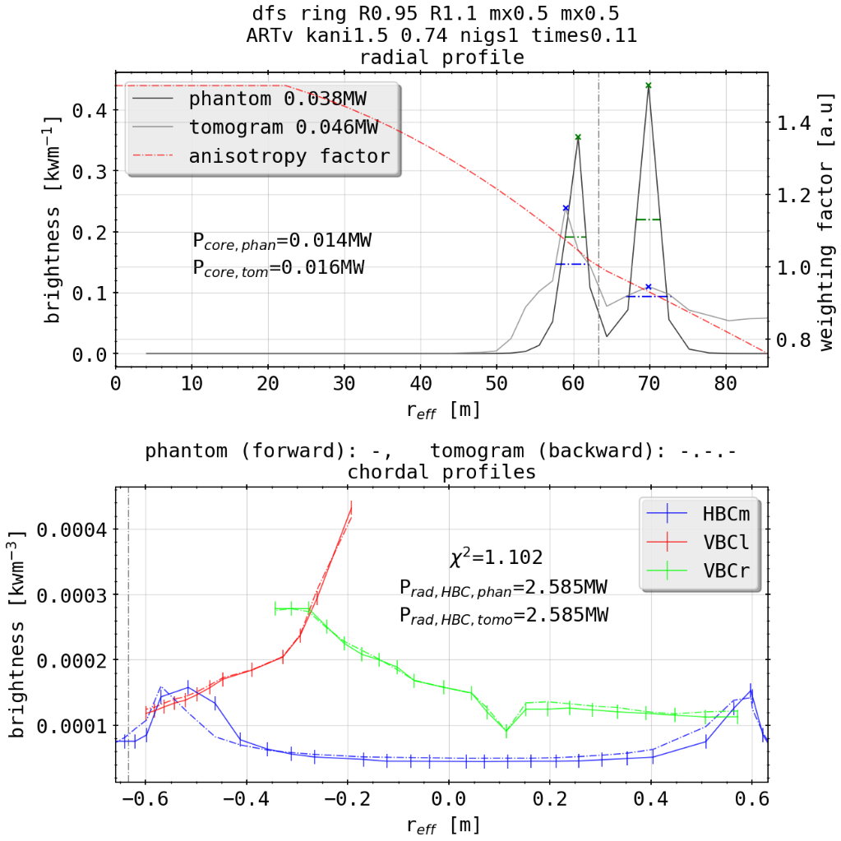
Phantom Test: Double Bright Rings
(1.1, 0.85)
[cm]
(1.1, 0.85)
[mm]
merging
(1.1, 0.9)
tomograms
radial scan
(1.1, 0.9)
(1.1, 0.95)
(1.1, 0.95)

Slide 18
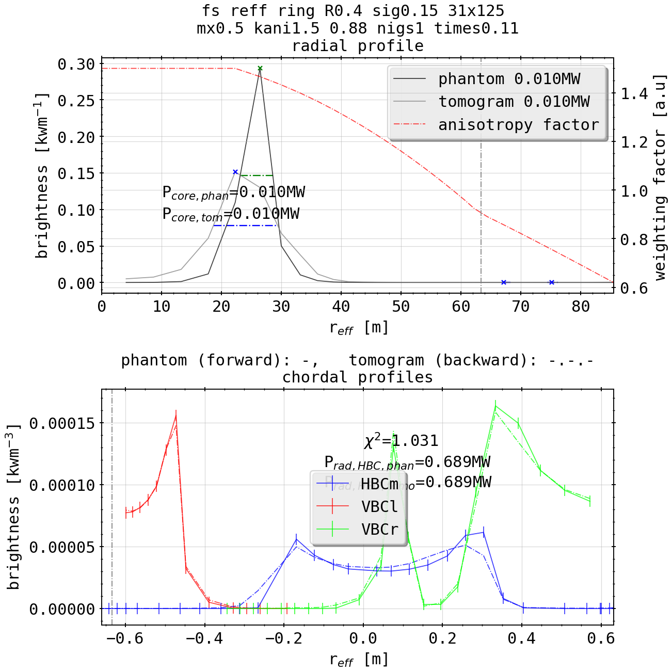
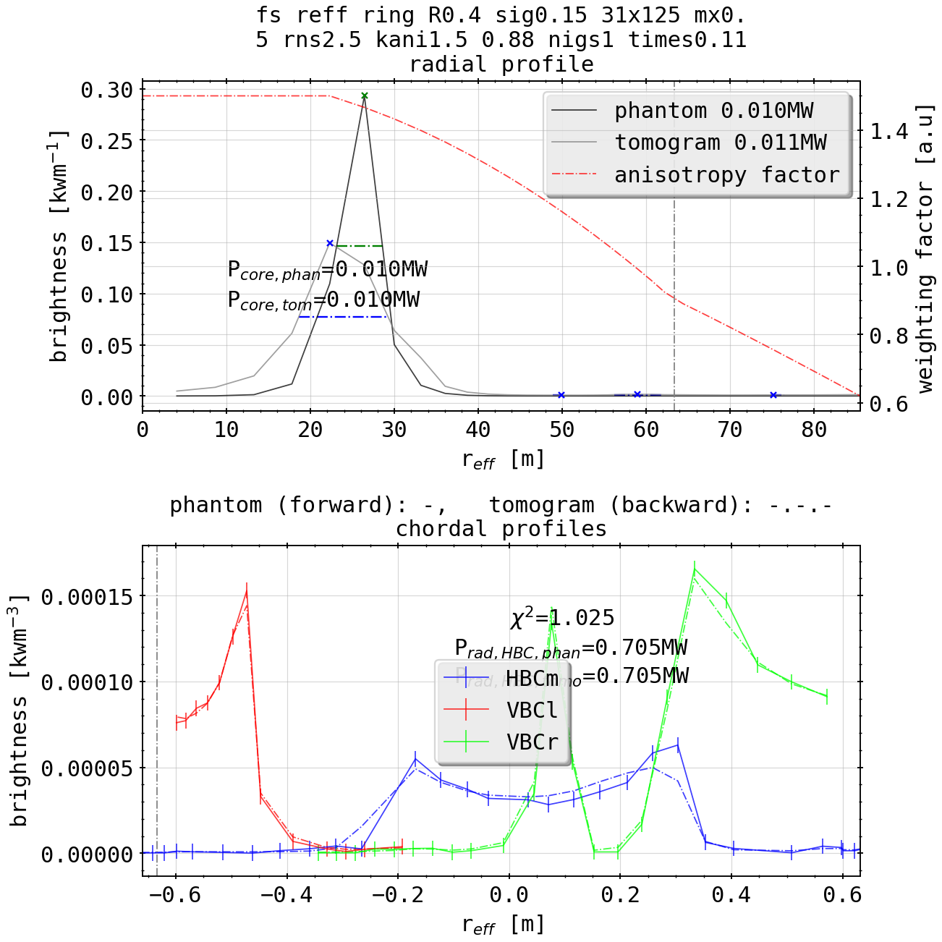
Phantom Test: Bright Ring Radial Scan w(w/o) 2.5% noise
adding random 2.5% of maxima of random noise to chordal data to go into reconstruction method on intrinsincly symmetric profiles
test robustness of method towards asymmetry in signals, gauging what eventually might be something discussed earlier in the geometry analyses with STRAHL
2.5% random noise to chordal data

Slide 19
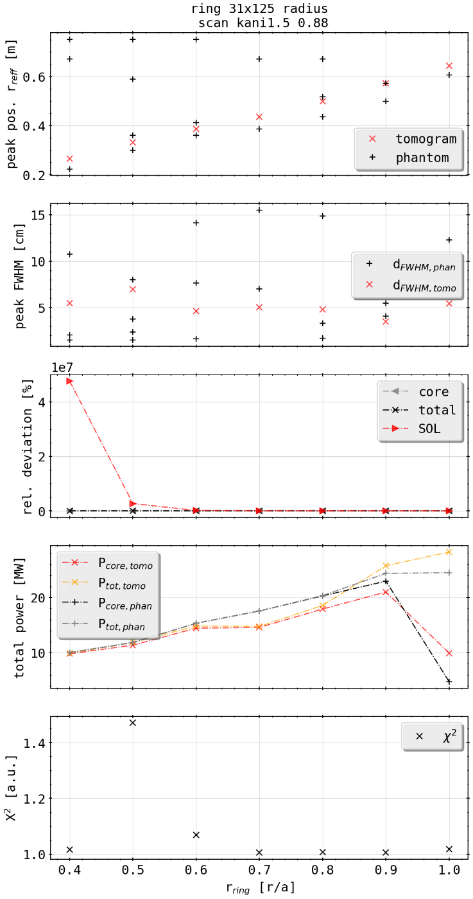
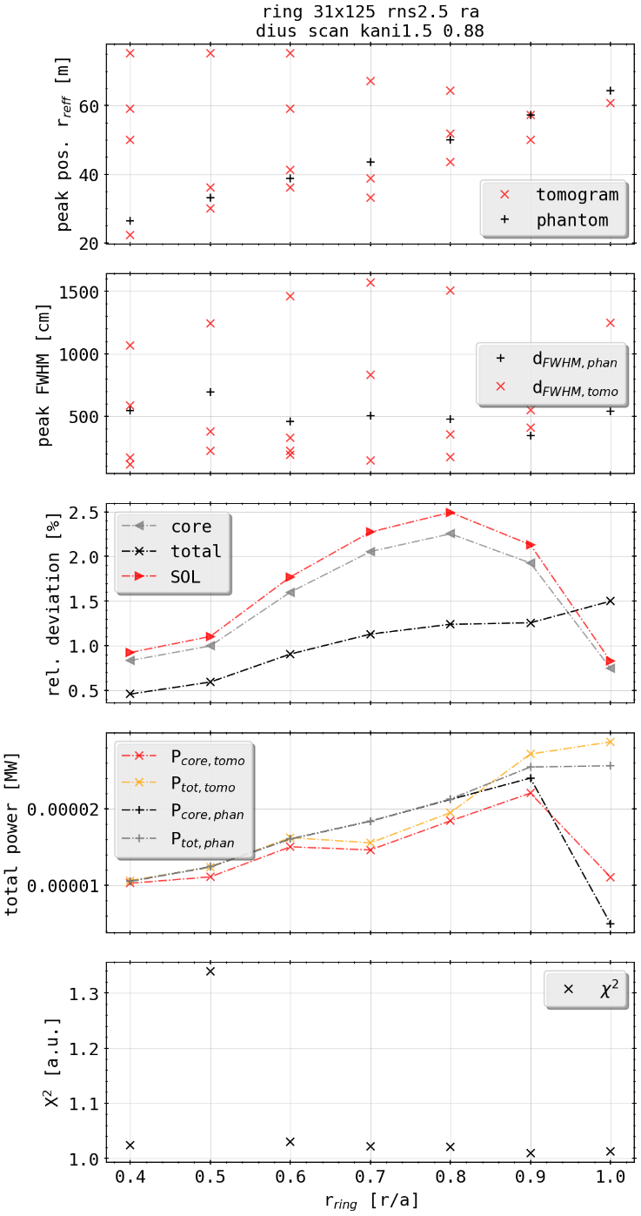
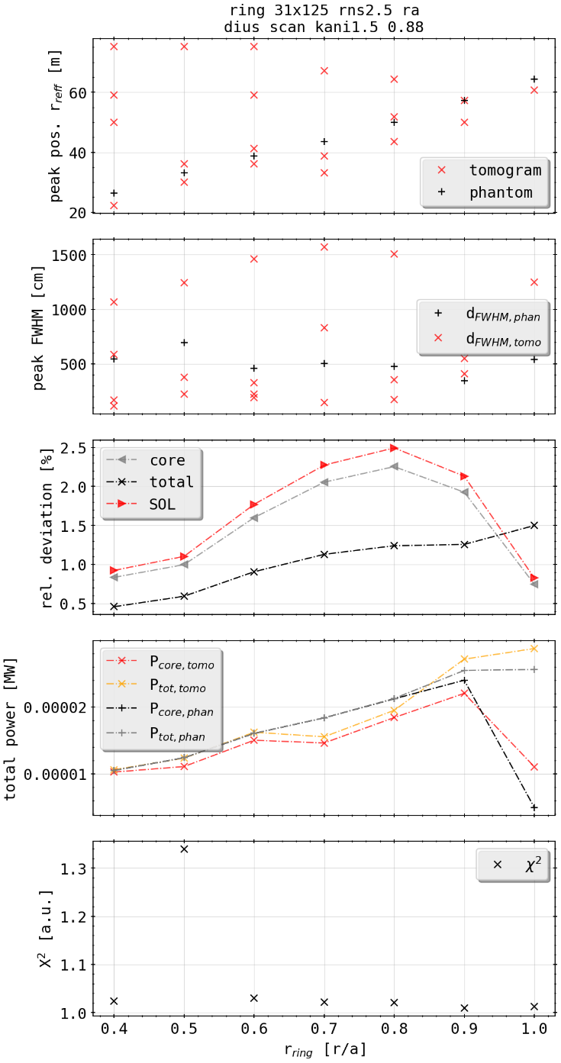

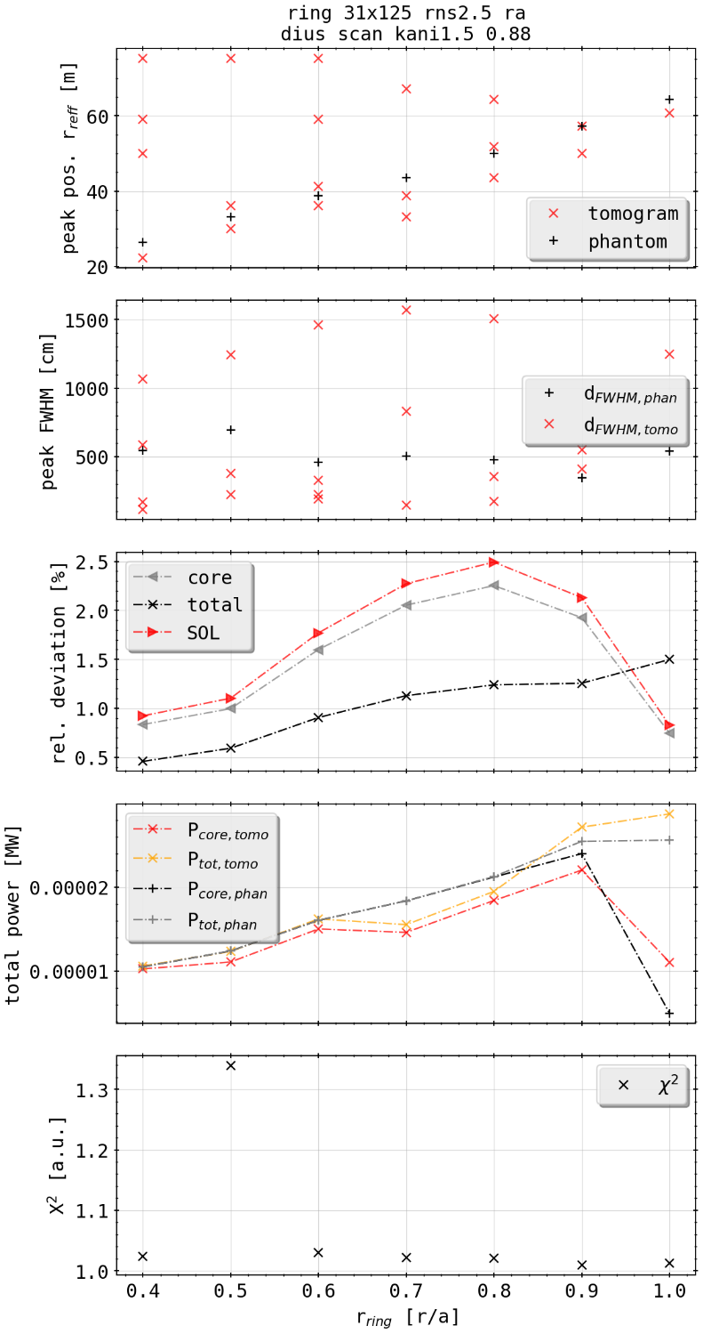

Phantom Test: Bright Ring Radial Scan w(w/o) 2.5% noise
[cm]
inversion not affected by reasonable amount of measurement error
2.5% smaller than experimentally experienced error
Gaussian error propagation yields much smaller level of deviance, but need to check orders/units of measurements again (based off of 6 measured quantities)
[mm]
w/o noise
with noise

Slide 20
Phantom Test: Bright Ring Radial Scan w(w/o) 2.5% noise
[cm]
radial scan shows for one set of K factors there is best set of numbers for reconstruction (radially, 2D)
inverse of previous problem (set of K for profile): suggesting unique solution for principle shape of phantom
[mm]
w/o noise
with noise

Slide 21
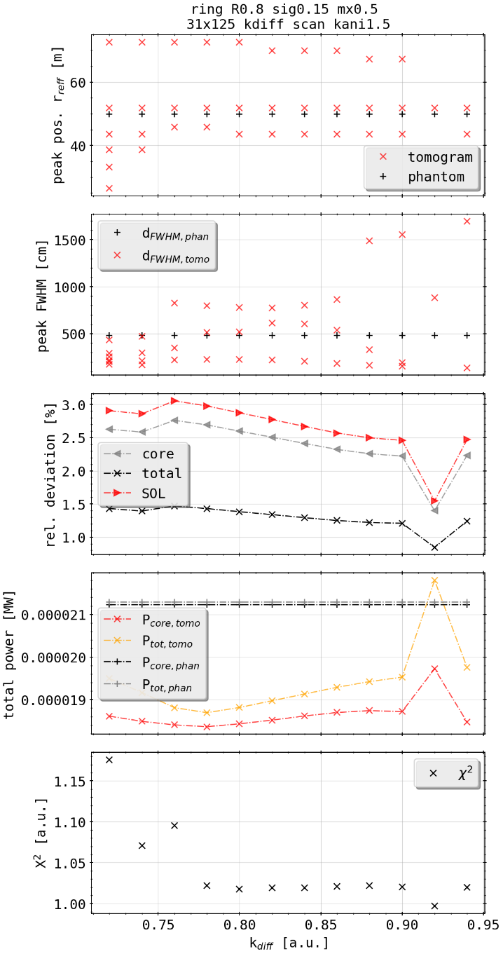
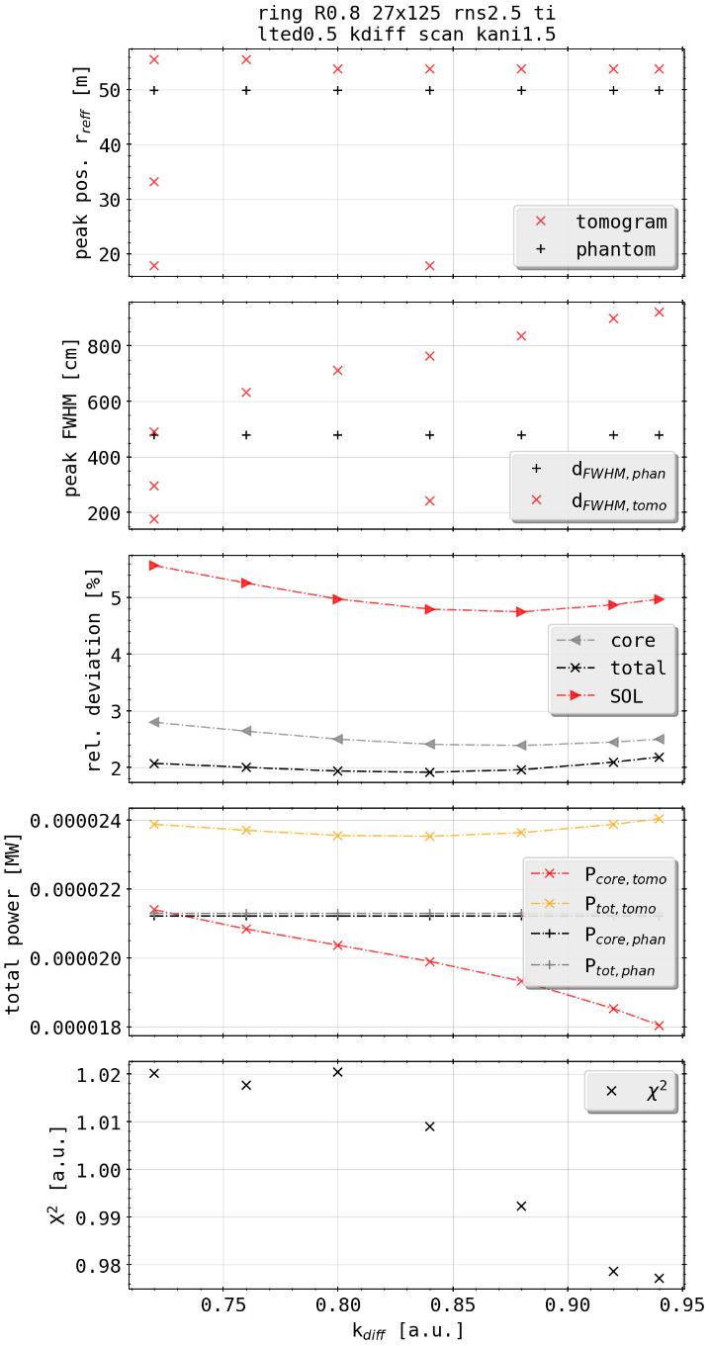
Phantom Test: Ring with 2.5% Random Error and Tilted Camera
use geometry previously set up when investigating the effects of errors to emissivities
add similar 2.5% noise to chordal profile, simulating actually measured experimental profile
change of best fit parameters according to 2D deviation and X² measurement
standard error in peak localization radially changed and increased
[cm]
[mm]
w/o error
with error

Slide 22
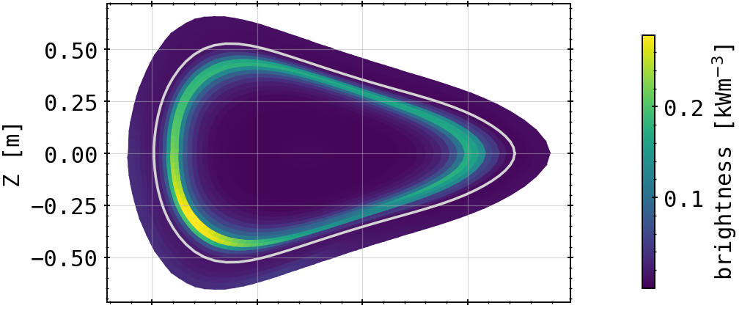
Phantom Test: Ring with 2.5% Random Error and Tilted Camera
[cm]
(phantom)
[mm]
(w/o error)
w/o error
with error
(with error)
radially shifted outside systematically
28.06.2020

Slide 23
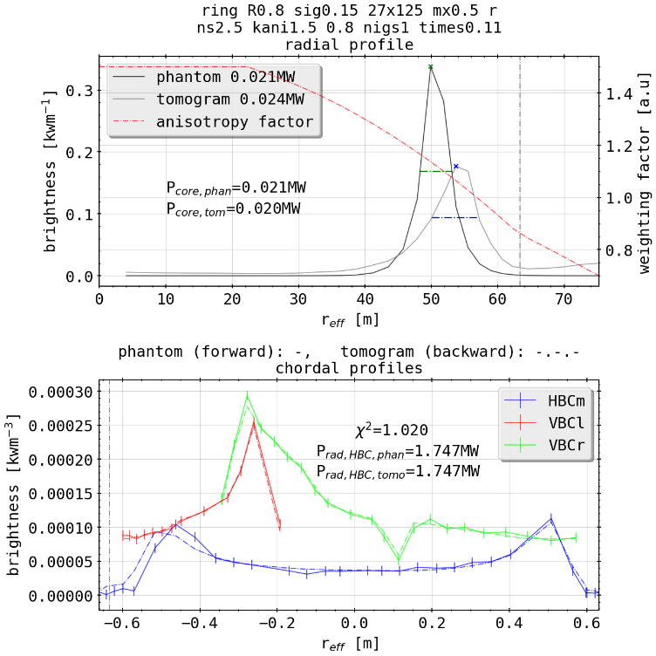
Phantom Test: Ring with 2.5% Random Error and Tilted Camera
[cm]
(w/o error)
[mm]
outward shift
w/o error
with error
Chordal peak orientation changed
(with error)
28.06.2020

Slide 24
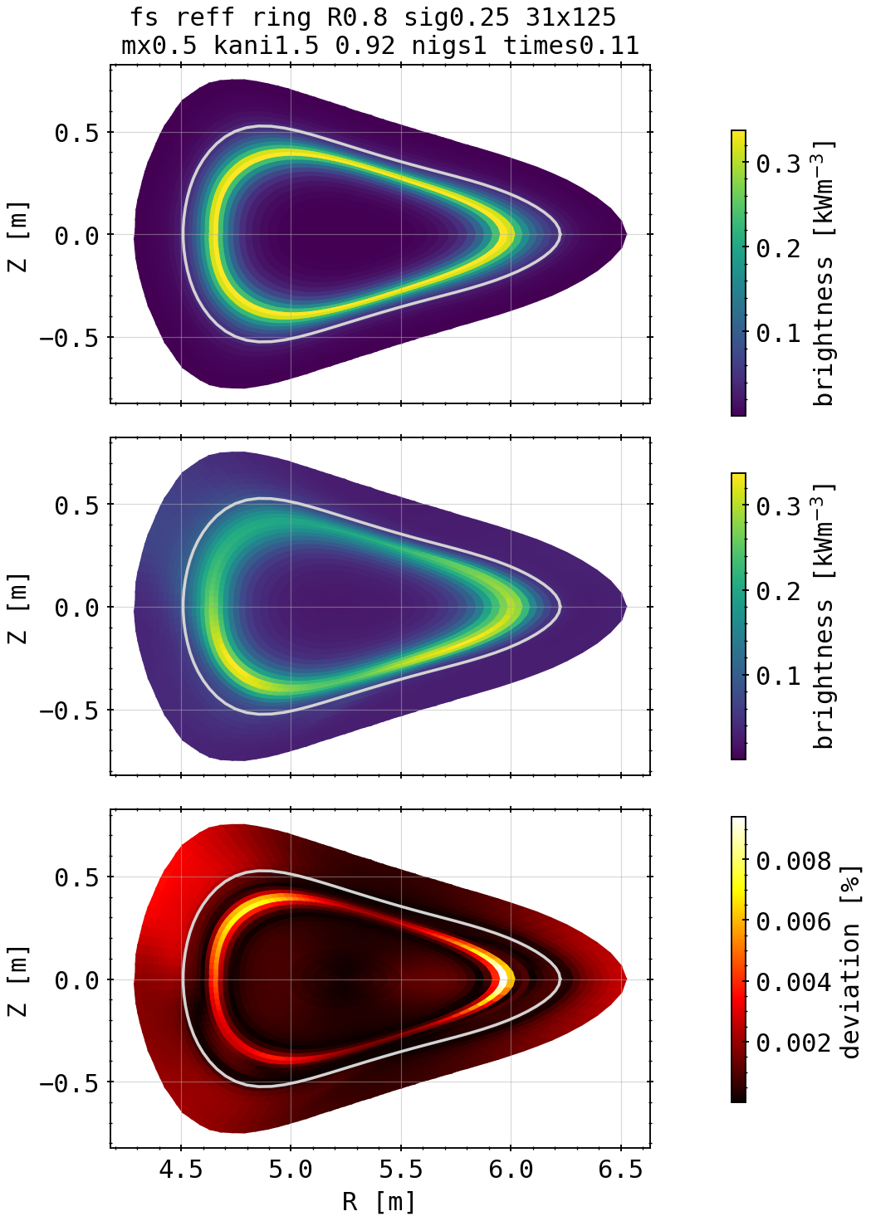
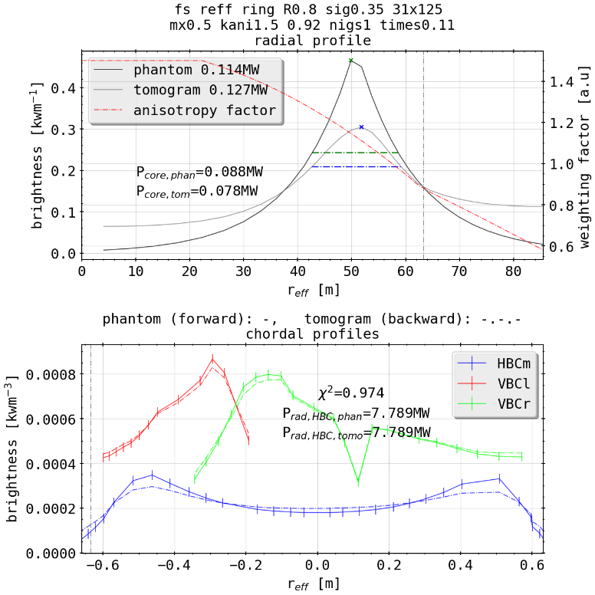
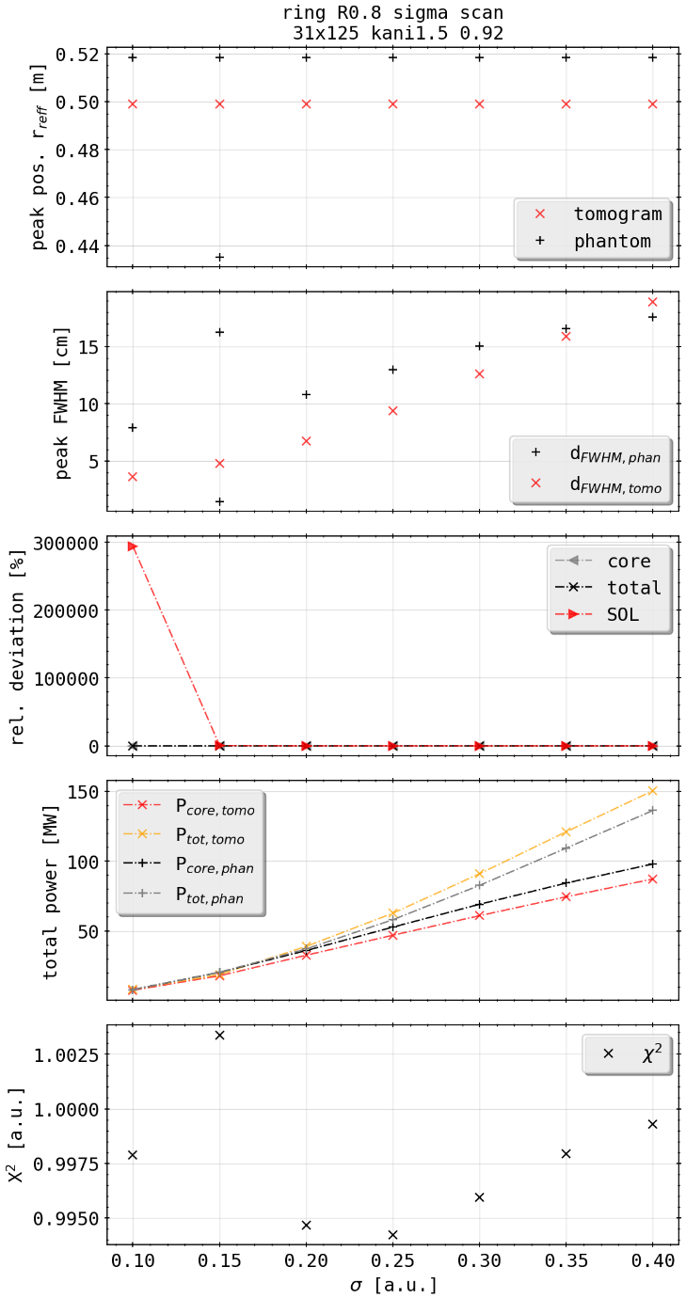
Phantom Test: Bright Ring Sigma Scan
[cm]
(phantom)
[mm]
sigma scan
(tomogram)
altering radial profile of bright ring
general profile representable, poloidal asymmetries persist
large sigmas cause deposition again beyond LCFS

Slide 25
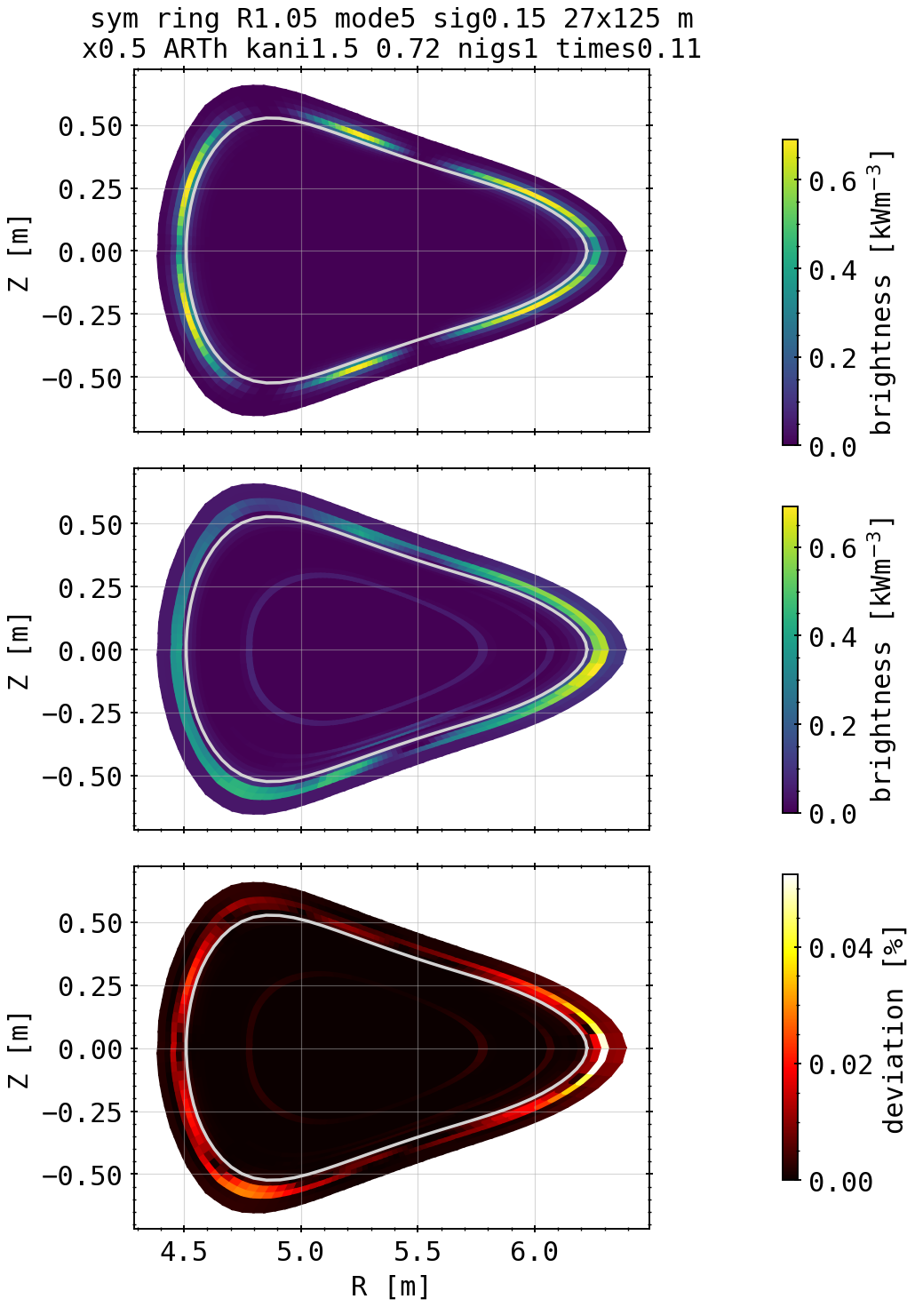
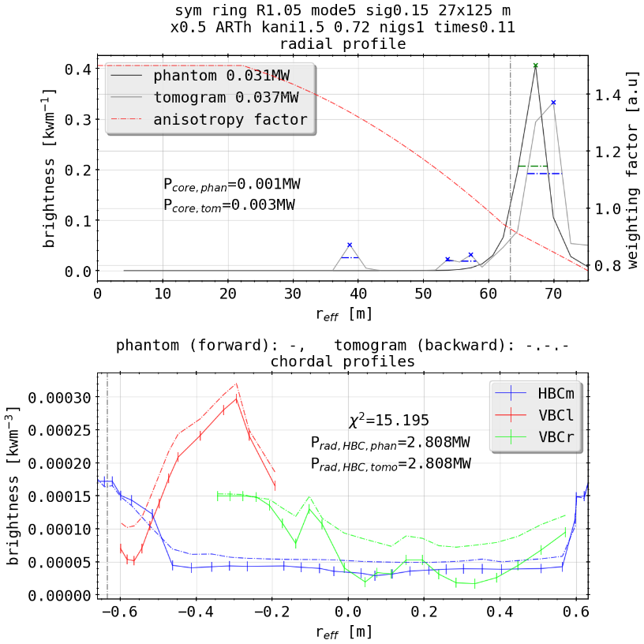
Phantom Test: Symmetric Island Mimic (mode = 5)
bad reconstruction overall, radial positioning however good
poloidal structure only somewhat distinguishable on outboard and lower side
LOS density on inboard side too low to resolve islands
Fix by higher LOS count/more cameras at different positions or angles?
(very high X², bad fit)

Slide 26
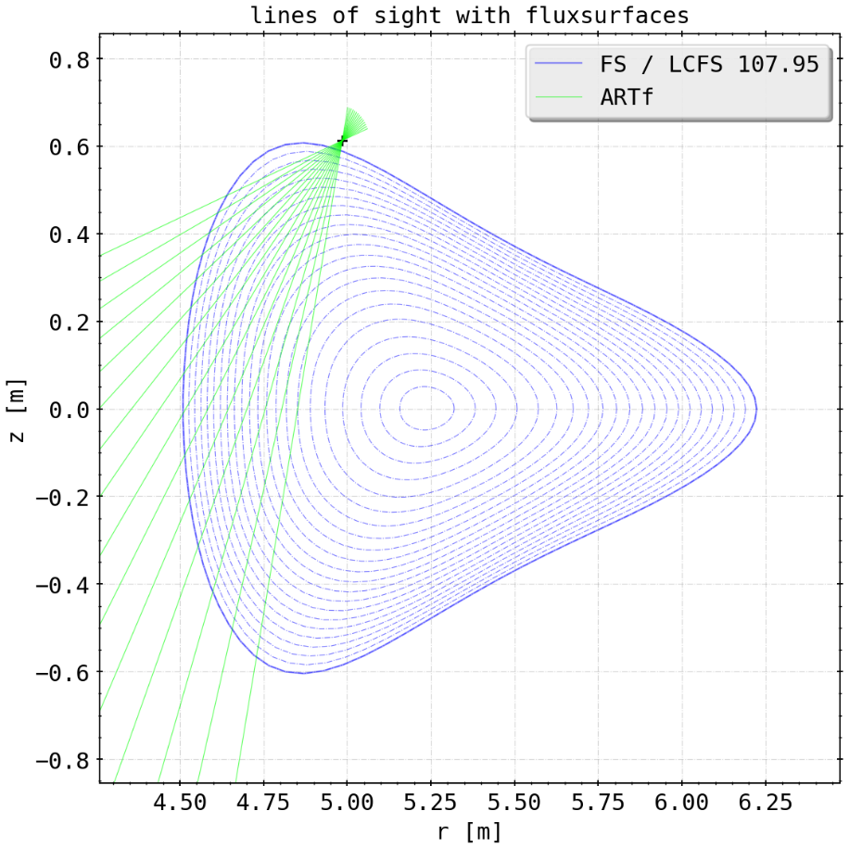
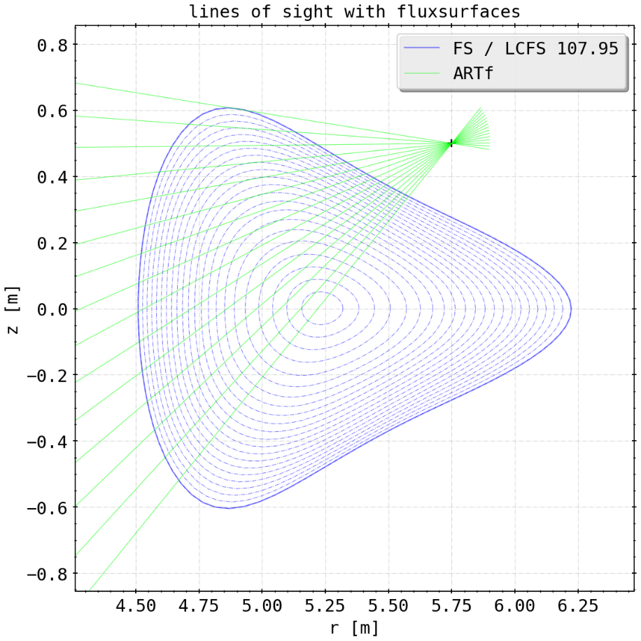
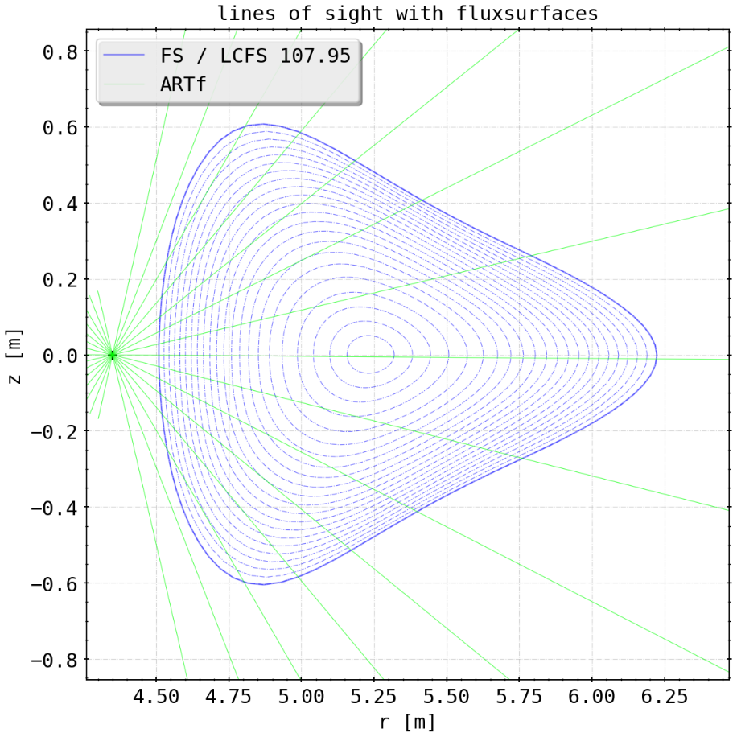
Phantom Test: New Cameras
adding new cameras at possible (1. 2) or impossible (3) positions, 15 channels, 1 at a time
ARTv (1)
ARTm (3)
ARTh (2)

Slide 27
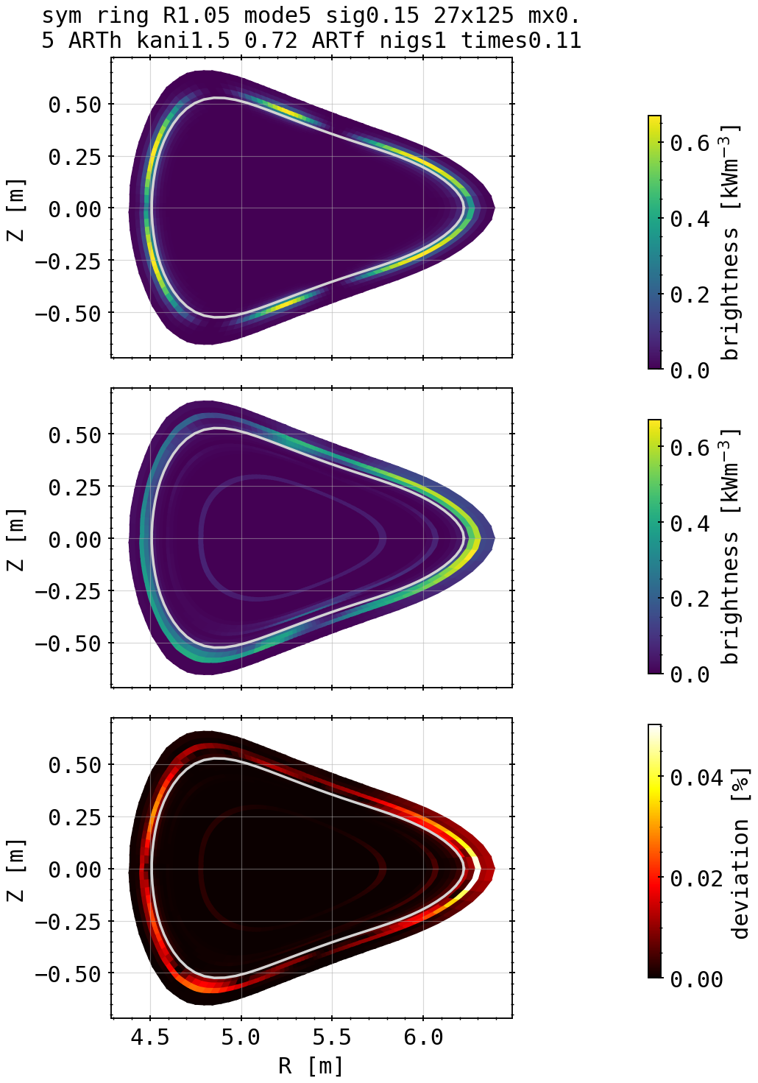
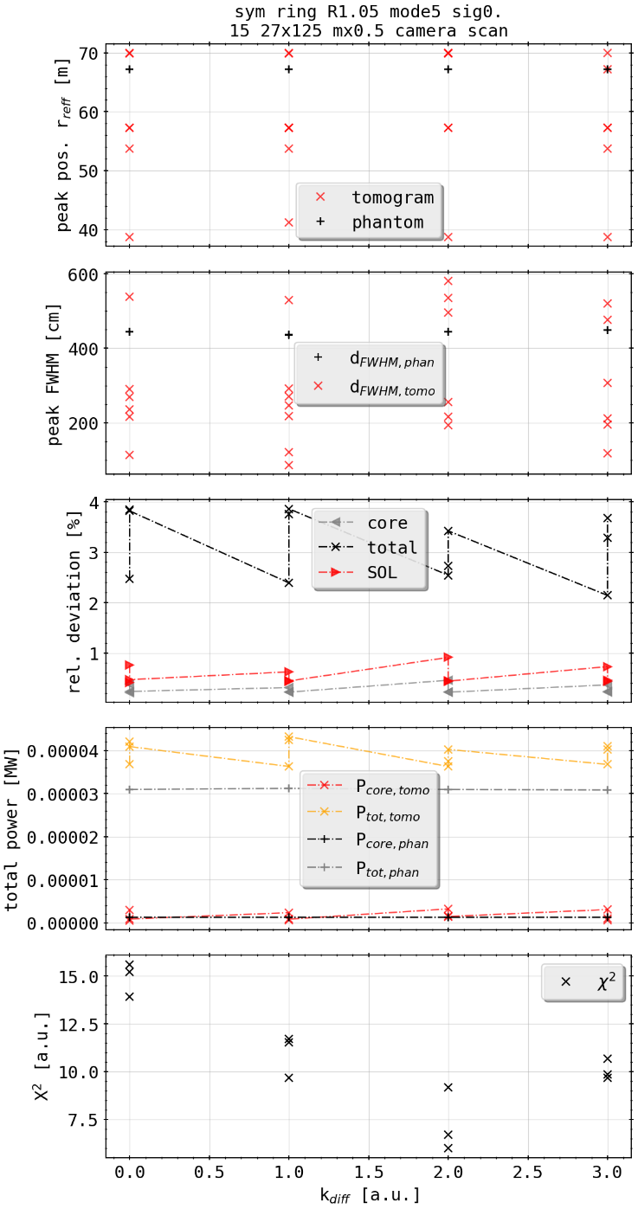
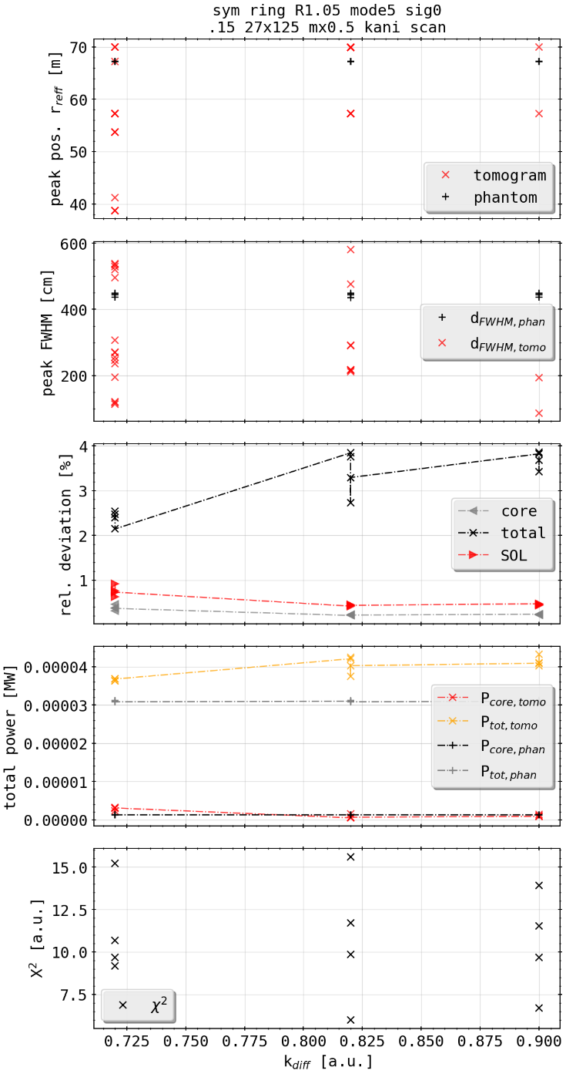
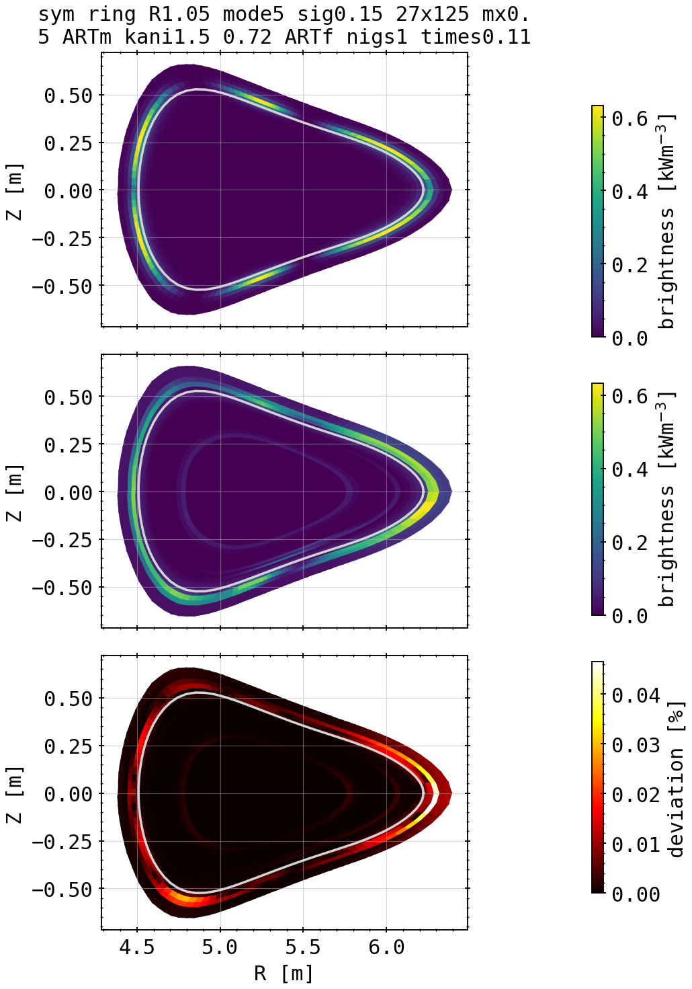
Phantom Test: Symmetric Island Mimic (New Cameras)
ARTh (2)
tomograms
camera scan
K factor scan
ARTm (3)

Slide 28
Phantom Test: Symmetric Island Mimic (New Cameras)
ARTh seems to be best arctificial, additional camera according to X²
2D reconstruction not inherently better though, inboard characteristics are still no resolvable with given restrictions (coverage, number of channels, pinhole positions, …)
different approach to K factor might help, TBD
camera scan
K factor scan

Slide 29
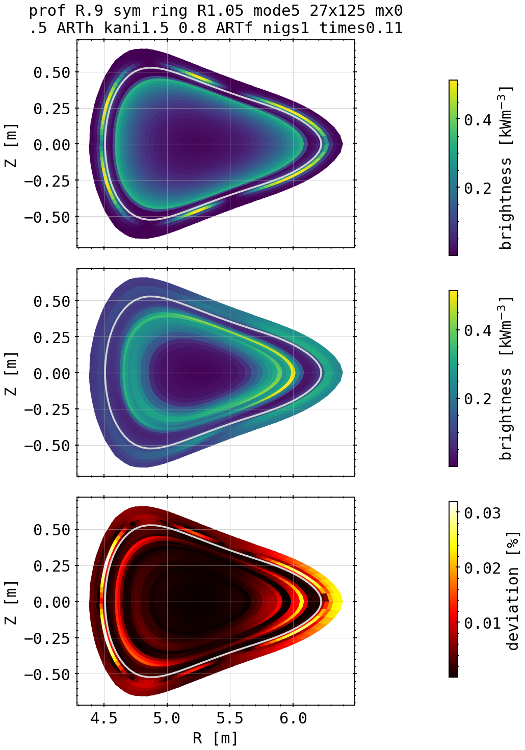


Phantom Test: Island Mimic and Radial Profile
ARTh (2)
camera scan
K factor scan

Slide 30

Phantom Test: Island Mimic and Radial Profile
radial profile inside shadowing over island structure
virtually not reproducible if poloidaly symmetric emissivity profile is superimposed
outside emissivity focused in front of HBC
X² fits overall better
camera scan
K factor scan
ARTh (2)

Slide 31




STRAHL and XP: 20181010.032 Comparison
radiation fraction = 33%
(phantom)
(20181010.032)
(experiment)
(tomogram)
STRAHL
(already large X²)

Slide 32




STRAHL and XP: 20181010.032 Comparison
(phantom)
radiation fraction = 66%
(20181010.032)
(experiment)
(tomogram)
STRAHL

Slide 33




STRAHL and XP: 20181010.032 Comparison
(phantom)
radiation fraction = 90%
(20181010.032)
(experiment)
(tomogram)
STRAHL

Slide 34




STRAHL and XP: 20181010.032 Comparison
(phantom)
radiation fraction = 100%
(20181010.032)
(experiment)
(tomogram)
STRAHL

Slide 35
Preliminary Conclusion and Outlook
likely good (best?) resolution of inversion domain, both with reasonable accuracy and calculation time is 27x75 cells (radial times poloidal, 21 fluxsurfaces build the plasma core)
additional radial or poloidal points only add time to calculation and possible free parameters to fit emissivity (avoidable by changing the gradients along the aforementioned dimensions accordingly)

Slide 36
Preliminary Conclusion and Outlook
considering a given emissivity profile shape, there exists an ideal set of K factors constraining the ratio of poloidal and radial gradients according to the X² optimisation
not necessarily the same as defined by the lowest 2D deviation, whose optimisation also yields an optimal set of K factors
radial positioning of profiles is subject to the selection of K factors over the radius

Slide 37
Preliminary Conclusion and Outlook
poloidaly distributed profiles are, so far the data set, near impossible to reconstruct properly (especially on the inboard side)
asymmetric charateristics can be property of the underlying emissivity profile to the tomography, however some are introduced due to the line of sight geometry
combinations of profile shapes, especially poloidaly symmetric and any else become hard to distinguish from one another (see ring and island mimic)

Slide 38
Preliminary Conclusion and Outlook
bright spots on-/off-axis and, e.g. bright rings can be separated from each other depending on the distance
individual bright sheaths can no longer be reconstructed radialy when closer than 0.2m
STRAHL reconstructions are largely accurate in position and value
reference XP 20181010.032 difficult to invert, subject to better profiles of K factors?

Slide 39
Preliminary Conclusion and Outlook
possibly find better approach to K factor profile shape for island mimics or combinations (double rings as well?) and asymmetric phantoms
check orders of magnitude/units of results for plausiblilty

Slide 41








Phantoms: Asymmetric Spot Core Scan
1.35
1.5
X²=8.83
X²=1.43
Kcore=1.25, kdiff=0.8
1.4
1.55
X²=13.6
X²=12.27
X²=2.0
1.3
1.45
1.6
X²=8.0
X²=1.094
X²=6.98

Slide 42







Phantoms: Asymmetric Spot Core Scan
1.75
X²=180.9
1.65
1.8
X²=28.75
X²=317.9
1.7
X²=82.28

Slide 43







Phantoms: Asymmetric Spot Edge Scan
0.65
0.8
X²=3.01
X²=1.43
Kcore=1.5, kdiff=0.55
0.7
0.85
X²=11.63
X²=1.99
X²=1.27
0.6
0.75
0.9
X²=6.58
X²=1.69
X²=1.09

Slide 44




Phantoms: Asymmetric Spot Core Scan
1.05
X²=10.07
0.95
X²=1.04
1.0
X²=11.7

Slide 45




Phantoms: Asymmetric Spot (Flipped) Edge Scan
0.95
X²=1.03
Kcore=1.5, kdiff=0.9
X²=1.07

Slide 46








Phantoms: Ring inside LCFS Core Scan
1.35
1.5
X²=1.02
X²=1.01
Kcore=1.25, kdiff=0.8
1.4
1.55
X²=32.8
X²=1.0
X²=1.04
1.3
1.45
1.6
X²=1.84
X²=1.04
X²=1.21

Slide 47





Phantoms: Ring inside LCFS Core Scan
1.75
Kcore=1.5, kdiff=0.8
X²=8.03
1.65
1.8
X²=1.44
X²=20.56
1.7
X²=2.51

Slide 48







Phantoms: Ring outside LCFS Scan
Kcore=1.4, kdiff=0.8
Kcore=1.5, kdiff=0.6
X²=1.007
X²=1.012
Kcore=1.35, kdiff=0.8
Kcore=1.6, kdiff=0.8
X²=1.004
X²=1.012
Kcore=1.45, kdiff=0.8
Kcore=1.5, kdiff=0.55
X²=1.001
X²=1.038

Slide 49







Phantoms: Island Mimic outside LCFS Scan
Kcore=1.7, kdiff=0.8
Kcore=1.5, kdiff=1.0
X²=19.38
X²=1.01
Kcore=1.6, kdiff=0.8
Kcore=1.5, kdiff=0.55
X²=9.79
X²=6.98
Kcore=1.65, kdiff=0.8
Kcore=1.5, kdiff=0.6
X²=6.208
X²=6.16

Slide 50




Phantoms: Combinations

Slide 51




Phantoms: Combinations
X²=4.87
X²=5.56

Slide 52




Phantoms: Combinations

Slide 53



Revisited: Cartesian Test, No Anisotropic Weighting

Slide 54

Revisited: Cartesian Test, No Anisotropic Weighting

Slide 55













Revisited: Test of 20180725.044
KJM magnetic configuration
chordal profile HBCm

Slide 56

Revisited: Test of 20180725.044
KJM magnetic configuration
chordal profile HBCm

Slide 57
Revisited: Test of 20180725.044
KJM magnetic configuration
chordal profile HBCm

Slide 58
Revisited: Test of 20180725.044
KJM magnetic configuration
chordal profile HBCm

Slide 59
Revisited: Test of 20180725.044
KJM magnetic configuration
chordal profile HBCm

Slide 60
Revisited: Test of 20180725.044
KJM magnetic configuration
chordal profile HBCm

Slide 61
Revisited: Test of 20180725.044
KJM magnetic configuration
chordal profile HBCm

Slide 62
Revisited: Test of 20180725.044
KJM magnetic configuration
chordal profile HBCm

Slide 63
Revisited: Test of 20180725.044
KJM magnetic configuration
chordal profile HBCm

Slide 64
Revisited: Test of 20180725.044
KJM magnetic configuration
chordal profile HBCm

